Slide 1
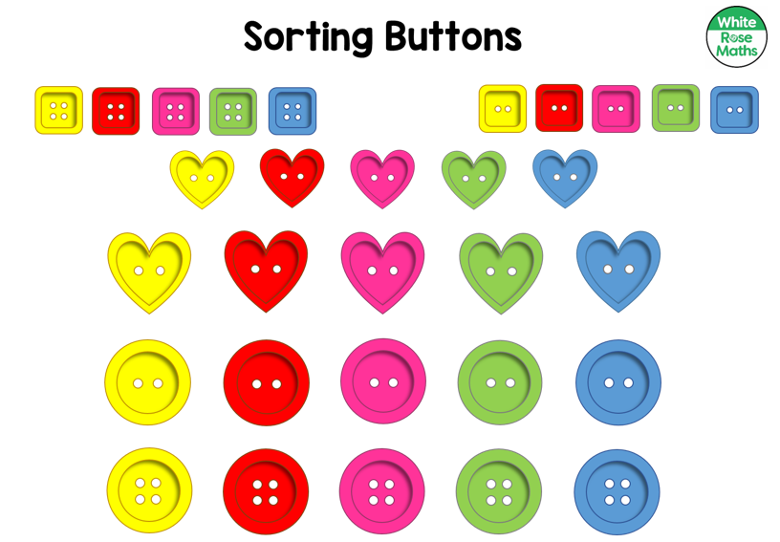
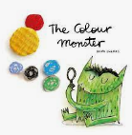
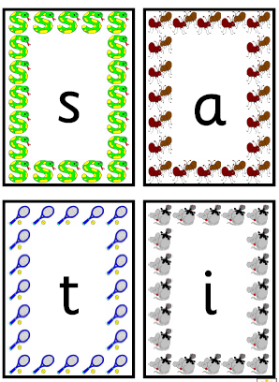
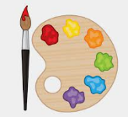
Communication, Language and Literacy Develop social phrases e.g. “good morning, how are you?”, “yes please”, “no thank you”. Understand how to listen carefully and why listening is important Listen to and talk about stories Describe events Learn and use new vocabulary |  | Books The texts we will be using during this topic will include: | Mathematics Match and sort Compare amounts Compare size, mass and capacity Exploring pattern
Phonics - Begin phase 2 phonics Recognise letters and the sounds they make. Segment and blend simple CVC words e.g. ‘c a t’ – cat | Handwriting Introduce patterns circles, spirals, lines, diagonals, jellies and zigzags, loopies and waves. |  | Physical Development Fine motor – using a range of focused and independent activities to strengthen fingers – tweezers, small beads, threading, scissors, using cutlery, playdough Gross Motor – Squiggle and Wiggle, transporting large materials, balance, bikes, trikes and scooters, tree climbing. PE – Superheroes – focusing on look, move, avoid and developing a Growth Mindset
 |  | What Makes Me, Me? What Makes Me Happy? Autumn 1 Hedgehogs class
Expressive Arts and Design Being imaginative and expressive - Nursery rhymes, number songs, sounds linked to feelings and colours. Keep a steady pulse with some accuracy (eg clapping, marching, tapping). Imitate movements in response to music. Creating with materials - Paint, water colour, chalk, water, sand, collage. |  | Personal, Social and Emotional Development Exploring the setting and be confident to try new activities. Talk about likes/dislikes. Talk about own and others behaviour and it’s consequences. Play co-operatively, taking turns with others. Show sensitivity to others needs. How do I and others show feelings? How does other people’s behaviour make me feel? Learn when to say sorry | Understanding the World People, Culture and Community - Why is the word God so important to Christians? Past and Present – Name and describe people who are familiar. The Natural World – Know about and name body parts. Describe what different body parts do Explore how our bodies change. Think about how we are similar and different

