Slide 1
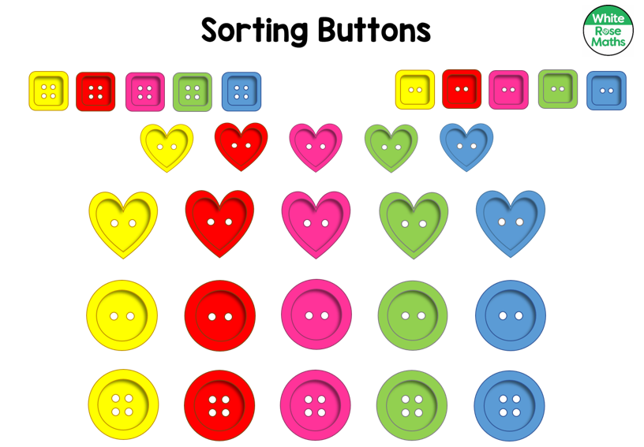
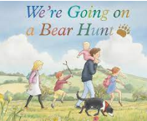
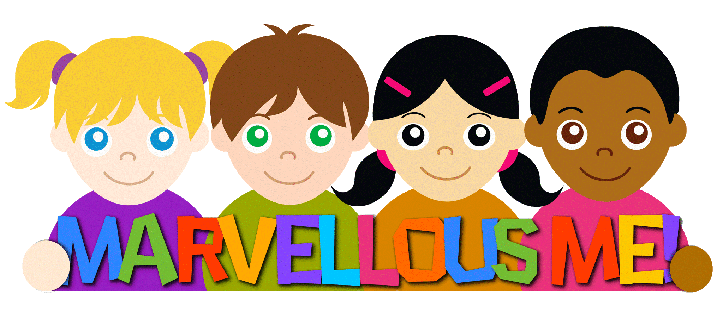
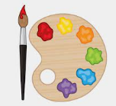
Communication, Language and Literacy Develop social phrases e.g. “good morning, how are you?”, “yes please”, “no thank you”. Understand how to listen carefully and why listening is important Listen to and talk about stories Describe events Learn and use new vocabulary |  | Books The texts we will be enjoying this half term will include: | Mathematics Match and sort Compare amounts Compare size, mass and capacity Explore pattern
Phonics - Begin level 2 Twinkl phonics Recognise some letters and the sounds they make. Segment and blend simple CVC words e.g. ‘t-a-p’ - ‘tap’ Read high frequency words: ‘the’ ‘no’ ‘go’ ‘I’ | Handwriting Introduce patterns circles, spirals, lines, diagonals, jellies and zigzags, loopies and waves. |  | Physical Development Fine motor – using a range of focused and independent activities to strengthen fingers – tweezers, small beads, threading, scissors, using cutlery, playdough. Gross Motor – Growth Mindset Superheroes Look, Move, Avoid
 |  | Marvellous Me Autumn 1 Hedgehogs class
Expressive Arts and Design Being imaginative and expressive Music - Pulse Keep a steady pulse with some accuracy (eg clapping, marching, tapping). Create movements in response to music. Explore and respond to long and short sounds. Creating with materials Drawing - Marvellous marks Exploring mark making through different drawing materials. Beginning to draw from observation using faces and self-portraits as a stimulus. |  | Personal, Social and Emotional Development Self-regulation: My Feelings We will be learning to explore and understand our feelings, identify when we may be feeling something, and begin to learn how to communicate and cope with our feelings and emotions. Health and Safety - People you can trust Everyone’s Welcome – Blue Chameleon by Emily Gravett – We are all different but we are all friends. | Understanding the World People, Culture and Community My School Grounds - How do I find my way around Belton school? RE - Being special - Where do we belong? Past and Present – Gain first hand experience of places of historic importance in Belton. The Natural World Our Body – Hands and feet. Why are we all unique? - Know that we have similarities and differences Explore our Senses – Smell, touch, taste, hearing and sight.

