Slide 1
New Beginnings at Belton!

Slide 2
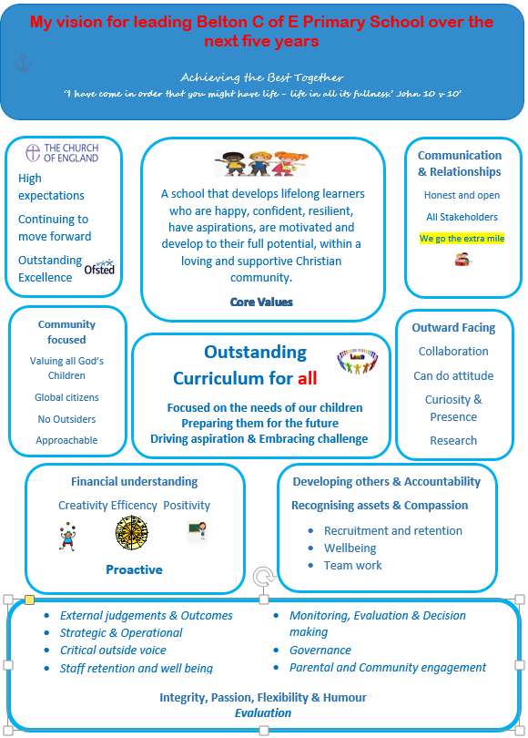

Slide 3
What to take with us moving forward
What makes Belton great?
How would we like Belton to develop /change?
What do we think our priorities as parents are for the school?

Slide 4
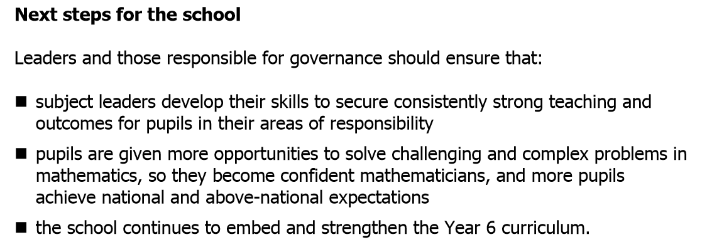
Ofsted and SIAMS recap
Areas for development • To develop the engagement of the school in wider partnerships including global links. •
For pupils to develop their role as leaders, in planning, leading and evaluating collective worship including taking part in prayer and also to enable the pupils to instigate and plan charitable and social action projects. •
To further develop the role of the whole governing body to strengthen monitoring and evaluation of the Christian character of the school in order to aid the new headteacher with strategic planning

Slide 5
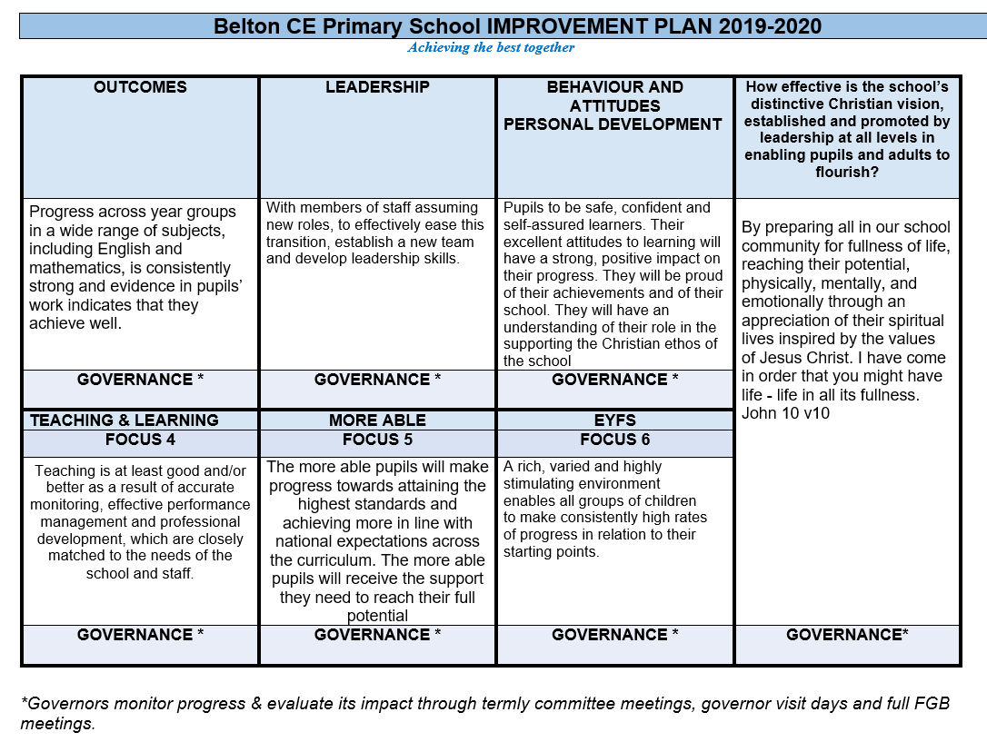

Slide 6
Off we go!

