Slide 1
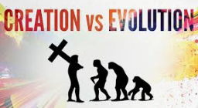
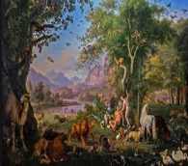
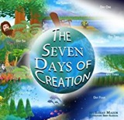
Being a Christian: LKS2 Knowledge Mat (L2.1 Y3)
Subject Specific Vocabulary
God | Who Christians believe is the creator and ruler of the universe.
Creation | The action or process of bringing something into existence.
 |  |  | Exciting Books
Bible | The Christian Holy Book which contains the old and new testament. | Sticky Knowledge - Creation: What do Christians learn from the creation story? (links to 1.2)
Adam and Eve | Who Christians believe were the first people on earth to be created by God. | Jews and Christians believe that God created the world.
 |  | Christians believe that God wants people to look after the world he created, all of its animals and nature.
Sins The Fall | An action that is or is felt to be bad. This happened when Adam and Eve disobeyed God’s instructions.
 |  | Some people believe that the world wasn’t created by God.
 |  | Adam and Eve are believed by some Christians to be the first people on earth. They believe they were created by God.
 |  | Christians believe that Adam and Eve went against God’s wishes – The Fall. This is when Adam and Eve ‘fell’ from their close relationship with God. This was the first ‘sin’.

Slide 2
Being a Christian: LKS2 Knowledge Mat (L2.1 Y3)
Subject Specific Vocabulary |  | Sticky Knowledge - Creation: What do Christians learn from the creation story? (links to 1.2)
God
Creation Bible
Adam and Eve |  | Who created the world?
 |  | What did God want people to do?
Sins The Fall
 |  | Do all people believe in the creation story?
 |  | Who created Adam and Eve?
 |  | What happened at the fall?

