Slide 1

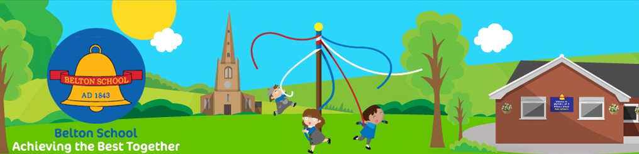
Belton Church of England
Primary School
Our Vision Statement
Achieving the Best Together
by preparing all in our school community for fullness of life, reaching their potential, physically, mentally, and emotionally through an appreciation of their spiritual lives inspired by the values of Jesus Christ. John 10 v10

Slide 2

Welcome – 2025/2026 Prospectus
School Name: Belton C of E Primary School
Address: Sadlers Wells
Belton
Loughborough
Leicestershire
LE12 9TS
Telephone: 01530 222304
E-mail address: office@beltonprimary.org
Website: www.belton.leics.sch.uk
Headteacher: Miss J Scott
Chair of Governors: Mr J White
Parent Governors Mr G Smith
Mrs R Harrison
Type of School: Primary school for day pupils
aged 4 to 11 years
School Hours: 8.45 am – 12 noon
and 1 pm – 3.10 pm

Slide 3
Our Staff
Headteacher: Miss J Scott
Deputy Head Teacher: Mrs C Yendall
(Head teacher on Thursdays & SENCO)
Teaching Staff: Mrs E Peczek
Miss A North
Mrs K Scarcliffe
Mrs J Ghirardelli
Learning support assistance: Mrs M Eves-Hopkins
Mrs D Jackson
Mrs J McClemont
Administration officer Miss A Mason
Premises Officer: Mr M Peat
Lunchtime Supervisors Mrs L Kay
Mrs J Lavine
Breakfast Club Mrs J Lavine
Mr M Peat
School Food Support Operated by LTS Catering Mrs N Gordon

Slide 4
Our School
IS BELTON THE SCHOOL FOR YOUR CHILD?
“This is a welcoming school. Pupils said that they are happy. They attend well. They enjoy learning across a broad range of subjects. Pupils are well prepared for their next steps in education”
The extract above is taken from our most recent Ofsted inspection report.
(October 2023)
Other comments made in the report are outlined below:
Pupils know and understand the high expectations that teacher have of their conduct. Pupils behave well. They are respectful towards their peers and adults.
Parents and carers are very positive about the school
Parents describes the school as one that ‘celebrates each unique child and cultivates a love of learning’.
A copy of the full Ofsted report can be obtained by visiting the Ofsted website (www.ofsted.gov.uk)
We are extremely proud of the outcome of our most recent Ofsted inspection. However, we do encourage you, to undertake your own inspection by visiting the school and allowing us to share our achievements with you personally! Please contact the head teacher to make arrangements for a visit who will be pleased to show you round and answer any questions you may have.
Everyone at Belton C of E Primary School would like to extend a very warm welcome to you and your child as you enter our school.
This prospectus is designed to answer many of the questions that you will undoubtedly have at this time and which will enable your child’s entry into our school to be as happy and productive as possible. We hope that by outlining our basic philosophy and aspirations for all those who attend Belton C of E Primary School, we will enable you to reflect on your role in supporting your child and make your child’s primary years successful!

Slide 5
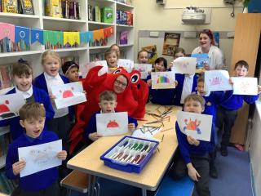
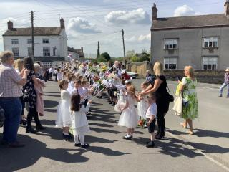
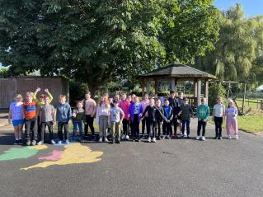
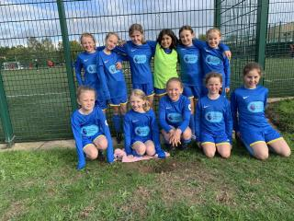
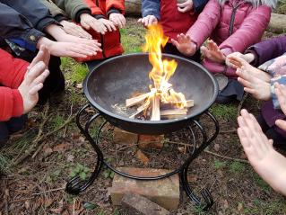
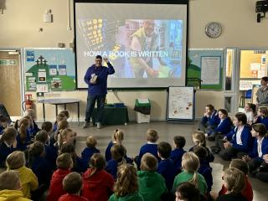
We Aim To
Develop lively, enquiring, healthy minds and independent learners
Develop and extend basic skills and help pupils to understand the importance of those skills and their continuing role throughout their lives
Develop an active partnership between the child, school and home
Recognise, develop and promote individual talents to promote wellbeing and confidence
Help pupils respect and communicate well with others, developing an understanding of spiritual, cultural and moral values and the appreciation of religious life and those ways of life different from their own
Help pupils appreciate the part they can play in society and understand their value and worth

Slide 6
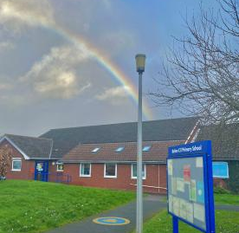
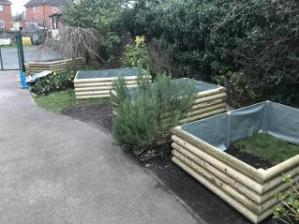
The School Environment
The school benefits from an early year’s area classroom, quiet room, toilets and cloakroom.
There is a large purpose-built kitchen in the Year 5/6 classroom which serves to extend and enrich aspects of education and encourages healthy eating and food preparation.
Individual classrooms are equipped with interactive whiteboards – a powerful tool for delivering the curriculum.
Belton C of E Primary School is a safe, secure environment where self-confidence is promoted and individual success, positive attitudes to learning and excellent behavior and resilience are promoted.
Belton C of E Primary School was founded in 1843. The present school was built in 1976 and stands within spacious grounds surrounded by open countryside, offering children a pleasant environment in which to play and plenty of space for the many sports activities available at school.
Two large playground areas are used at playtimes and PE lessons. There is an enclosed area for Foundation Stage children. This is used as an extension to the classroom as we value learning both indoors and outdoors.
A gazebo and amphitheatre further enhance the outdoor learning environment and in keeping with our ethos of promoting healthy living and being active, an adventure playground provides a challenge for older pupils. There are raised garden beds at the sides of the school where we grow plants and vegetables. The forest school area enhances learning and offers opportunity for interaction with nature at first hand.
There are four classrooms arranged around a large hall. All classrooms have their own stocks of books and there is a non-fiction library situated in the hall.

Slide 7
The School Day
Free School Meals:
Free school meals Application forms for free school meals are available on request from the school office or online: https://www.leicestershire.gov.uk/education-and-children/social-care-and-supporting-families/free-school-meals
These are available to any family whose income is below £16,190 per year. Although meals for all infants are now Government funded, we would still ask you to complete the application if you fall into this category.
Milk:
Children under 5 are entitled to free milk and older children in school may purchase it. If you wish your child to have milk at break, please order it from the Coolmilk website
https://www.coolmilk.com/
Fruit and snacks:
Children in Reception and Key Stage 1 have access to free fruit at break.
Local playgroup links:
We have a excellent links with our local Belton playgroup who offer afterschool collection from school for parents who require further childcare outside of school hours.
https://www.beltonplaygroup.co.uk/opening-hours-fees-funding/
Our school gates open at 8.35 am, with five minutes for the children to make their way into classrooms for 8.40 am sharp.
Children have break time 10.15am until 10.30 am.
Lunchtime runs from 12.00pm until 12.55pm.
The school day finishes at 3.10pm.
Breakfast club and afterschool:
School staff run a breakfast club from 7.45am until 8.45am Monday to Friday
After school clubs Tuesday, Wednesday and Thursday, usually until 4.15pm.
Lunch:
Hot or cold lunch is available throughout the week, children order this with their teacher during registration.
School meals for children in Foundation Stage, Years 1 and 2 are Government funded i.e. free to children in Classes R, 1 and 2.
Children in Years 3, 4,5 and 6 can have school lunches at the cost of £2.65 per day.

Slide 8
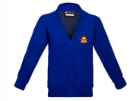

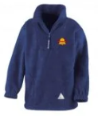

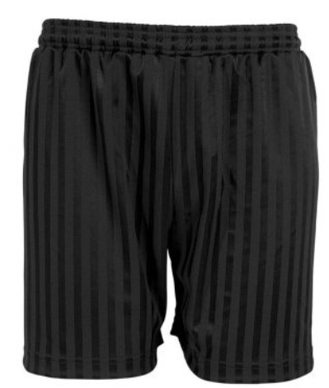
Uniform
For PE all children need
Indoor PE
Plain round neck T shirt in house colour red, green, blue and yellow
Black / navy blue shorts
Black plimsolls
Drawstring bag (clearly labelled with child’s name)
Outdoor PE:
A hoodie (plain in house colour red, green, blue and yellow)
Black or navy-blue tracksuit/jogging bottoms/leggings
Trainers
We believe that school uniform increases the children’s pride and ownership of their school and we insist on children at Belton Primary school wearing a uniform.
Uniform can be ordered through sports advocate - https://sportsadvocate.co.uk/schoolwear/belton-ce-primary/
Our colours are royal blue, grey and white and the required all year uniform is as follows:
Blue sweatshirt, cardigan or fleece with logo (logo optional)
White or blue polo shirt, white shirt or white blouse
Dark grey trousers, shorts, pinafore dress or blue and white gingham dress (all year- choice is given to what style the children can wear)
Grey/white socks/grey tights
black sensible school shoes/boots (not trainers)

Slide 9
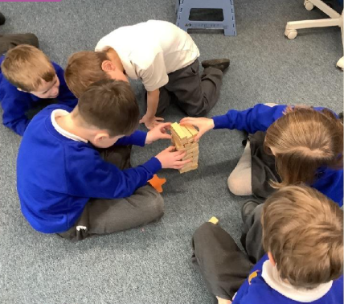
Curriculum Matters
All children develop both academically and socially through focused teaching
and through discovery, in recognition that each child is unique.
At Belton we give each child a rich, broad, balanced and relevant curriculum in
accordance with the National Curriculum and enhance experiences beyond this
being aware that the curriculum is everything a child learns.
The curriculum is organised so that we enable all children to:
Read fluently and accurately, with understanding and pleasure.
Write neatly and display a good standard of use of English.
Listen carefully and express themselves orally and in writing in a confident, clear manner appropriate for different purposes.
Develop the ability to use IT equipment and software to communicate and handle information.
Acquire skills of numeracy and computation and increase their ability to use and apply mathematical solutions in everyday life.
Develop the skills and attitudes that assist them to become independent learners.

Slide 10
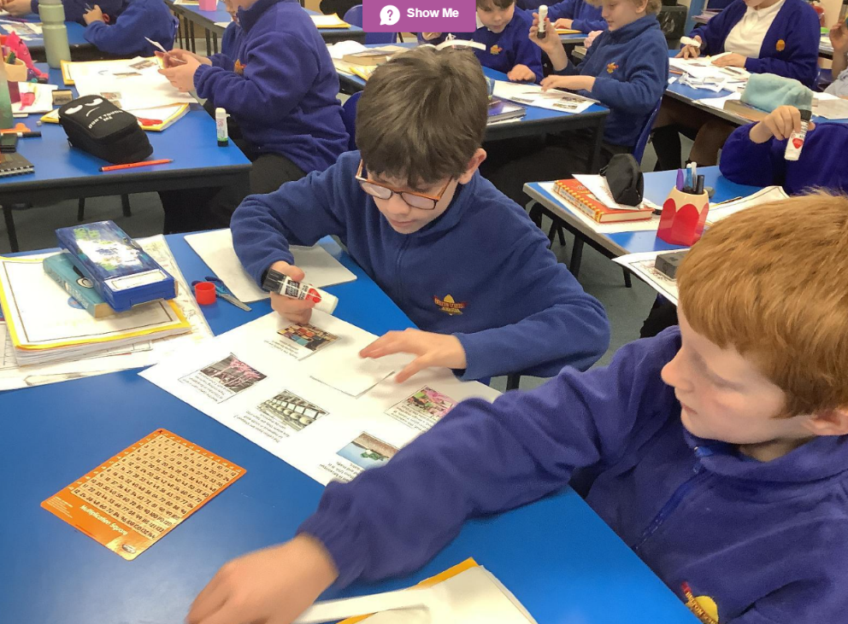
Curriculum Matters
Develop an understanding and appreciation of our national heritage
and diverse multi-cultural society.
Promote an understanding of their bodies in action leading to positive
attitudes towards a healthy lifestyle
Develop an understanding of spiritual and moral issues.
National Curriculum
All classes are taught the appropriate statutory programmes of study for the National Curriculum.
Reception pupils follow the Early Years Foundation Stage. Children in Years 1 & 2 follow the Key Stage 1 Curriculum. Children in Years 3, 4, 5 & 6 follow the Key Stage 2 Curriculum.
Assessment and target setting are well developed from the Early Years Foundation Stage Profiles to Standard Attainment Tasks (SATs) at the end of Year 2 and year 6.
All children have targets which are regularly reviewed and monitored in order to assess whether attainment is matching expectations.

Slide 11
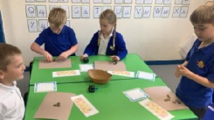
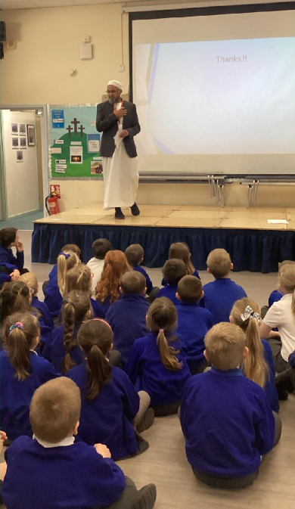
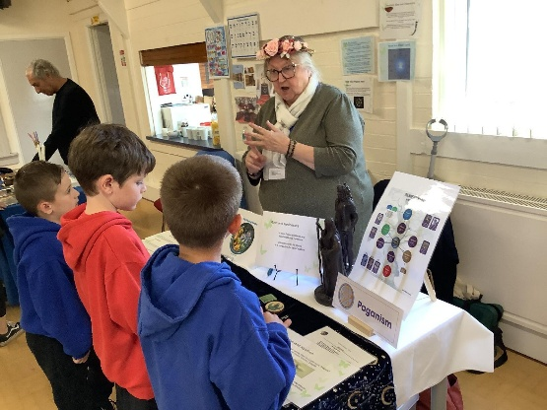
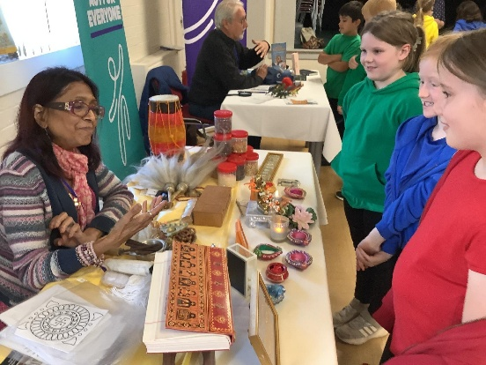
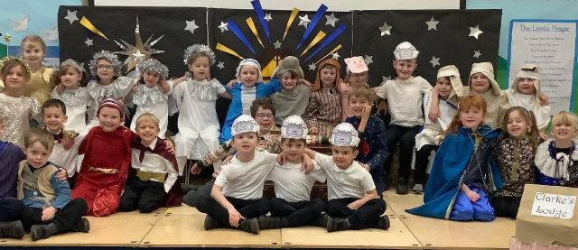
Religious Education & Collective Worship
Collective Worship
We invite children to take part in daily acts of worship. Collective worship provide opportunities for the enhancement of the pupils’ spiritual, moral, social and cultural development and celebrate and reaffirm the school’s values.
Religious education
Our lessons aim to educate children to celebrate our world diversity and looks at a wide variety of religions and world views. Religious Education teaching is in accordance with the Leicestershire Diocesan Board of Education Syllabus for RE.
All children attend the worship unless parents and carers wish otherwise. Parents and carers have the right to withdraw their child from Religious Education and Collective Worship.

Slide 12
Special Educational Needs and Disability (SEND)
At Belton C of E Primary School, we are proud of the support that we give to all children. However, for children with special educational needs (SEND) we recognise that it is even more important that their support needs are quickly identified and speedily met.
Our policy and day-to-day provision for children with SEND is in line with guidelines of the Revised Code of Practice for Special Education Needs 2014 and is approved by the school governors. Further information or advice can be obtained from the special needs co-ordinator (SENCo), Mrs Catrin Yendall. The school special needs policy and local offer is on the website and is available to parents on request as a paper copy.
Children who are identified as having special educational needs are given appropriate support as defined by the Code of Practice. Parents and carers are involved in the process at all times.
The school has well resourced SEND provision – support staff, equipment and experience of working with children with a variety of special educational needs. School can readily access help from specialist professionals if required to support the needs of a particular child. All staff, both teaching and support, involved in the special needs process, have undergone and continue to access appropriate training.

Slide 13
Behaviour and Discipline
We have a clearly defined system of sanctions and a step-wise approach to conduct and behaviour issues, so that children are aware of the consequence of their actions and feel that they are treated fairly. Most problems of discipline are dealt with by the class teacher, but where misbehaviour is more serious, the head teacher will be involved.
If persistent or more serious problems regarding discipline occur, parents are informed and their assistance sought. In very serious cases of misbehaviour it may be necessary to exclude a pupil, in consultation with governors and Parents and carers, initially for a short period of time.
Our ultimate aim is self-discipline and to achieve this we insist on compliance with the school rules.
At Belton C of E Primary School, we believe that school reflects society and plays an important part in developing essential life skills. We expect the children in school to be well behaved and respectful towards one another and towards adults and visitors and to be good ambassadors for our school. We expect our children to treat each other and all adults and visitors to the school with respect and courtesy. We expect that in light of our Christian character and one of our key Christian values that saying sorry and the act of forgiveness are intrinsic in the development of positive behaviour. We say “In this school we are kind and we show respect.”
High standards of behaviour are expected of every child in order to make the school environment a safe, harmonious and effective place for learning. We expect the full support of parents and carers in maintaining these standards. Good behaviour and self-discipline are encouraged and expected and experience shows that praise, positive attitudes and good role models are effective in delivering positive outcomes.
The school has a set of rules which encourage consideration for others and their possessions and are necessary for the safety and well-being of all children and staff. Children are aware of these rules and are expected to positively uphold them – in addition, they are encouraged to produce rules for their own classrooms.
Bullying
Bullying, in any form, causes much distress to the child involved and is not tolerated at Belton C of E Primary School.
The Governors and staff have developed a Managing Pupil Behaviour Policy and an Anti-Bullying policy both of which are available on the school website and to parents who request a hard copy from the office.
If a child feels that they have been bullied, they should inform one of the staff at school, or their parents/carers. Information will be logged and immediate action taken to deal with the situation.
Parents and carers and children should be reassured to know that all reports of bullying will be taken seriously by the school and acted upon appropriately.

Slide 14
Getting Involved
Becoming member of the FOB’s team is a great way to get more involved with the school. New members are always welcome.
Community partnership:
Belton C of E Primary School is proud of the strong links that have been forged between the local community and the school. We also encourage effective home-school links and value the partnerships fostered with parents and carers of children attending the school.
The following are just a few examples of the Community and home-school links that have been developed:
Participation in the church Harvest Festival by all children
A monthly assembly is held in church
The children and school are central to the traditional Maypole dancing ceremony and crowning of the May Queen. (Belton is one of the few villages in the country with a permanent maypole where this tradition continues)
The school has excellent links with the successful local playgroup, who visit the school regularly to introduce children to the school environment
Key Stage 2 children participate in a Christmas Carol Concert held in the church
A coffee morning is held annually in support of Macmillan
Friends of Belton (FOB’s):
FOB’s are a group of volunteers made up of parents, grandparents and staff who work together to raise funds for the school.
These fund have been put towards additional resources for the school, whole school trip to Twycross Zoo, transport to the pantomime, animal experiences and our year 6 leavers trip plus many more.
FOB’s usually meet once a term discuss and organise any up coming events. Some of the events they have organised in the past are as follows:
School Discos
Wreath making
Summer Fete
Bingo evenings
Easter egg hunt
Summer raffle
Matchbox challenge
Plant sale
Tea & cake afternoons

Slide 15
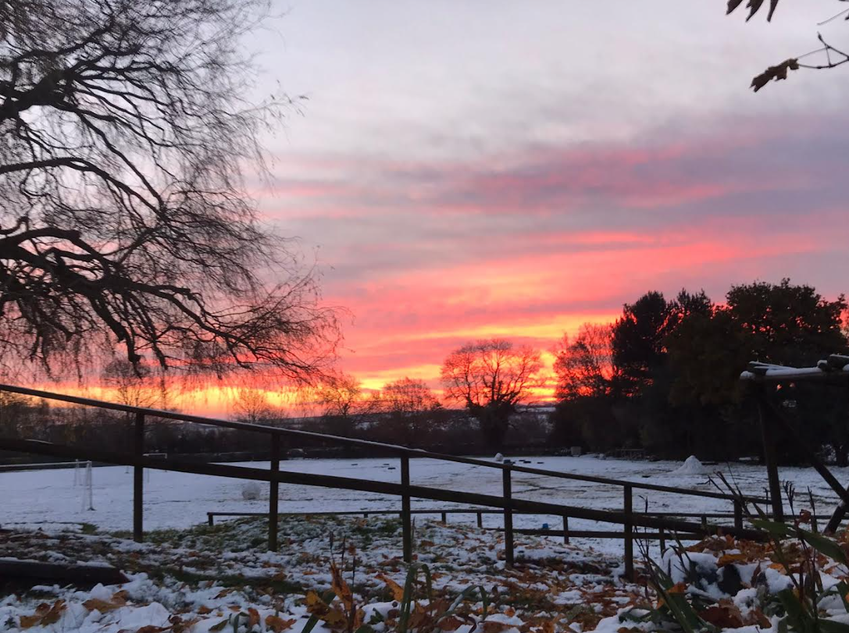
How to Apply
If you would like to arrange a visit so that you can come and see how wonderful Belton C of E primary School is, Please contact us on:
Telephone :01530 222 304
Email: office@beltonprimary.org
Admissions:
At Belton C of E Primary School we follow the local authority admissions criteria and applications for places at our school are managed by Leicestershire County Council; the school does not deal with places directly.
Contact by Phone: 01163056684
Email: admissions@leics.gov.uk
Website: https://www.leicestershire.gov.uk/education-and-children/schools-colleges-and-academies/school-admissions/apply-for-a-primary-school-place

