Slide 1








Belton C of E Primary School
Special Educational
Needs and Disabilities (SEND) Information report
2025 - 2026
Achieving the best together

Slide 2
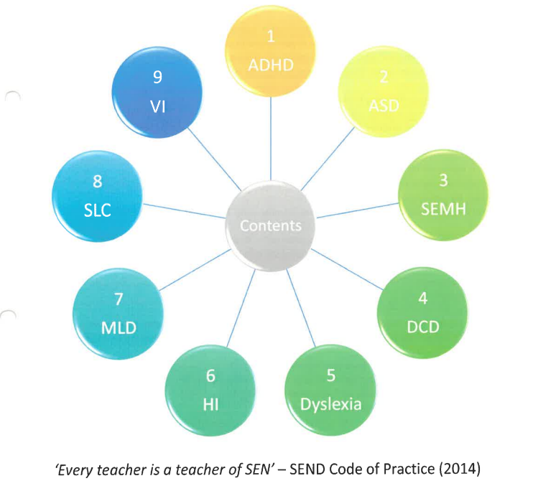
Quality first teaching
strategies
Please refer to these strategies before completing your initial concern from.
Achieving the best together

Slide 3
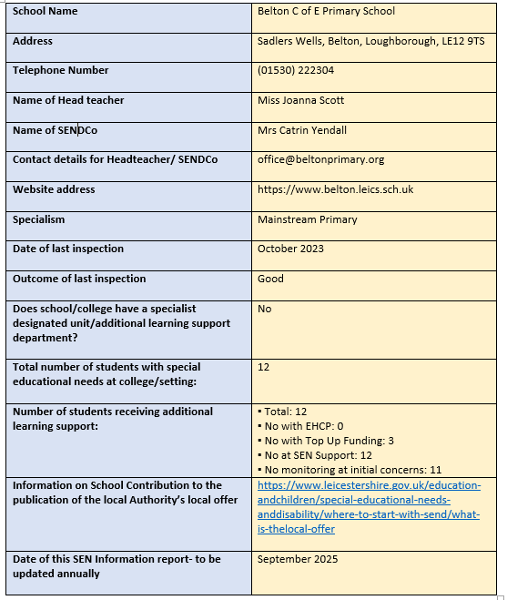








Slide 4
CONTENTS
  What are Special Educational needs and disabilities?
2. What is our approach to teaching pupils with SEND?
3. The graduated approach
4. What are the arrangements for consulting parents/carers of SEND pupils and the young people themselves and how do we involve them in the education?
5. What school policies do we have?
6. How do we support a parent/carer or young person with a concern?
7. What arrangements do we have for assessing and reviewing the progress of pupils with SEND?
8. How do we evaluation effectiveness of your provisions for pupils with SEND?
9. How do we support pupils with SEND transferring between phases of education or in preparing for adulthood and independent living?
10. How do we adapt the curriculum and learning environment for pupils with SEND?
11. How will equipment and facilities be secured?
12. What expertise and training does our staff have in relation to supporting and teaching pupils with SEND and how is the specialist expertise secured?
13. How are pupils with SEND enabled to engage in activities available to their peers without SEND?
14. What support is available for improving the emotional and social development of pupils with SEND?
15. How does the governing body involve other bodies in meeting the needs of these pupils and supporting their families?
16. What arrangements are made by the governing body relating to the treatment of complaints, from parents and carers of pupils with SEND, concerning the provisions made at our school?
17. The publication of LCC Local offer

Slide 5
1. What are Special Educational Needs and Disabilities (SEND)?
Belton CE Primary School prides itself on offering a supportive and caring environment which caters for children with various special educational needs. The school strives to be a fully inclusive school, fostering a sense of community and belonging through:
  Personalised learning
  A broad, balanced and creative curriculum for all pupils
  Early identification of barriers to learning.
  High expectations of all pupils
Children with SEND (Special Educational Needs and Disabilities) are children who may need extra help with learning, communication, moving around, or understanding things.
Everyone learns in different ways, and children with SEND might us special tools, support, or teaching methods to help them shine and do their best.
The broad areas of special educational needs are:
• Cognition and Learning difficulties
• Speech, language and communication difficulties
• Social, emotional and mental health difficulties
• Physical or sensory difficulties
2. What is our approach to teaching pupils with SEND?
At our school, we are committed to delivering Quality First Teaching (QFT)— this is an approach that ensures high-quality, inclusive education in every classroom. QFT is about providing consistently excellent teaching that meets the needs of all learners, regardless of their ability, meaning fewer children need something ‘additional to and different from’ their peers because their needs are being met through this approach.
We personalise learning, set high expectations for every student, and design whole-class instruction that is accessible and engaging for all. Our teachers are encouraged to create practical, hands-on lessons using visual aids and physical resources to deepen understanding and bring learning to life.

Slide 6
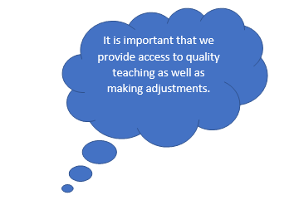
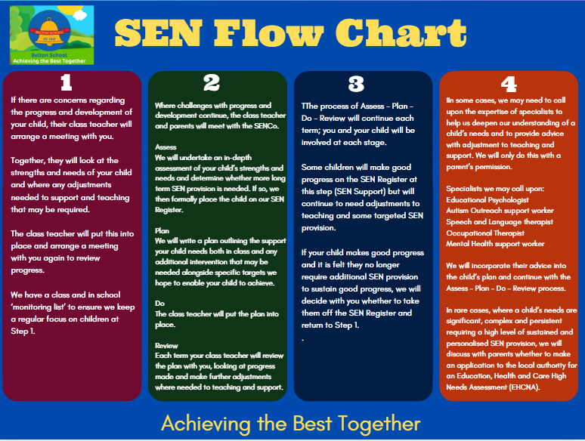
3. The Graduated Approach

Slide 7
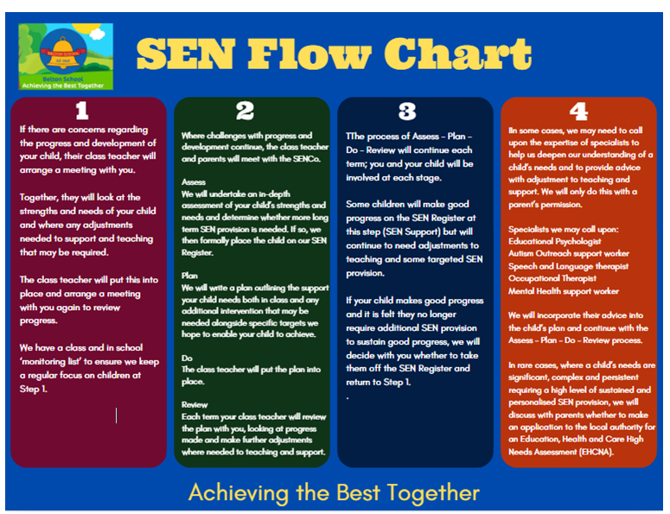
More Information
Education Health and Care Needs Assessment (EHCNA) - The Education, Health and Care Needs Assessment (EHCNA) is a process carried out by the local authority to decide whether a child needs an Education, Health and Care Plan (EHCP).
This assessment is requested when a child may require more support than is normally provided through the school’s SEND provision. Parents, the school, or other professionals can request an EHCNA. The local authority will gather information from the school, parents, and other professionals (such as educational psychologists or health specialists) to build a full picture of the child’s needs. The aim is to understand what support the child requires to make progress and ensure their needs are being met effectively.
Education Health and Care Plan (EHCP) - An Education, Health and Care Plan (EHCP) is a legal document for children and young people aged 0–25 who need extra support that goes beyond what is normally provided in school. It describes the child’s special educational needs, the support they need, and the outcomes they are working towards.
An EHCP brings together education, health, and care services into one clear plan, helping to make sure that everyone involved is working together to support the child’s development and learning.
An EHCP is reviewed yearly, unless an emergency review needs to be held.
4. How do we involve parents?
At Belton C of E, we believe that strong partnerships with our families are essential. We have an open-door policy and always listen to your views, concerns, and ideas. Our aim is to create a supportive environment where open, professional dialogue can take place to ensure the best possible outcomes for your child.
As soon as there is an initial concern, you will be informed by your child's class teacher. From this very first conversation, you will have the opportunity to offer your views and contribute to decision making.
If your child is put on the SEN register (detailed above in section 3) the Class Teacher (with the SENCO if required) will then meet with parents/carers, at least three times per academic year, to set clear outcomes, review progress and discuss activities and
Your paragraph text

Slide 8
support that can be used both in the home and school setting. We encourage you to share your views every step of the way so that we can work together to provide the best for your child.
Whether your child is on the SEN register or not, we hold termly open coffee mornings where you can drop in to meet and chat with the SENDCO. These meetings will also have a theme so you can understand how we support your child at school and how you can support your child at home. A half-termly newsletter is published with updates for parents.
Our SEN Governor meets with the SENDCo termly to discuss, review and support the school, before they report back to Governors.
See the contact details (p2) for information on how to contact us.
4.1 How do pupils participate?
We listen to our pupils and encourage them to take part in their learning. As the children move through our school, we want the children to evaluate themselves as learners and express opinions and make choices. All of our SEND pupils have pupil passports that are produced together with the pupil and their families. This enables them to identify their strengths and areas to improve, ways of learning best and support they may need. We encourage them to have a voice and we listen to and act upon their opinions around their education.
Each child has an individual target book with a target board to enable them to take ownership for their own learning. The children and teachers will have the opportunity to showcase these targets through photocopy of work, post its; making it a working document which will show progress and be shared with parents at review meetings. When reviewing targets, we always have conversations with children around their progress and next steps and we actively encourage them to provide feedback.

Slide 9
5. What school policies do we have?
The school has a policy for Special Educational Needs and Disabilities which explains how we identify pupils with SEND and what procedures we have in place. This can be found on our within the SEND website.
Other policies that link to SEND, which can all be found on our website, are:
  Accessibility policy and plan
  Anti-Bullying policy
  Behaviour policy
  Child protection policy
  Equal opportunities Policy
  First Aid policy
  Health and Safety Policy
  Inclusion policy
  Intimate care policy
  LAC policy
  Medication and supporting pupils with medical needs policy
  Off-site visit policy
  Physical intervention policy
  Privacy notice for pupils and their families
  PSHE and relationships, sex and health education policy
  Suspension and exclusion policy
The above policies, and all other policies we have as a school, can be fonnd following this link:
https://www.belton.leics.sch.uk/other_policies

Slide 10
6. How do we support a parent/carer or young person with a concern?
We are an approachable school where staff are happy to help if you have a concern or worry. Our school has an ‘Open Door’ policy and parents/ carers ar able to talk to staff in the morning or at the end of the school day. If the concern is class based, we encourage parents to speak to the class teacher first. These conversations can be arranged either at the start or at the end of the day or by contacting the school office.
If you are not satisfied with how the situation has been dealt with or if you feel you need to speak to the SENDCo or headteacher then you can do so by contacting the school office.
If you are still not satisfied, you can find the complaints policy on our website.
If a child/young person raises a concern to any member of staff, this will be taken seriously and communicated to the relevant people.
Teachers will monitor the concern and put relevant strategies in place if needed. We will then provide check-ins with that child to see how they are getting on and to receive feedback from them.
7. How do we assess and review children’s progress?
We closely monitor the progress of our pupils with SEND and regularly evaluate the support in place to ensure it is effective and meets individual needs.
Your child’s progress is reviewed throughout the year using both formal assessments and informal observations. Teachers and support staff record when they are working directly on a target with your child and track their progress carefully. Once a target is achieved, we plan the next steps and set a new one. If a target has not been met, even with high-quality teaching and tailored interventions, we adjust the provisions or the target to make it more achievable, while still aiming for meaningful progress.
As a parent or carer of a child with SEND, you will receive time, to discuss your child’s progress towards their specific SEND targets. These meetings are a chance to formally review progress and next steps with the class teacher, and sometimes the SENDCo, if appropriate. In addition, we maintain open communication with families, and your

Slide 11
child’s class teacher will keep you informed between these meetings as needed through informal conversations.
Our SENDCo works and headteacher carry out regular and focused monitoring of all SEND processes and provision. This includes observing lessons, reviewing pupils’ work, and gathering feedback.
Findings are shared with staff to ensure that high-quality support is consistently in place for all children with SEND.
8. How do we evaluate the effectiveness of provisions for pupils with SEND?
When monitoring the progress towards individual targets for children with SEND, we evaluate the provision we have in place for them and how effective it is. If the provisions are not supporting and allowing for progress, we will re-evaluate and make changes. This cycle is continuous.
9. How do we support pupils who are transferring?
We understand that transitions can be particularly difficult for pupils with special educational needs and we work closely with other schools and agencies to ensure the transition is as smooth as possible. We can arrange additional support for their high school transfer such as extra visits. If your child is moving schools to a new primary school, or coming from another primary school, then we will always endeavour to talk to the relevant staff in person and ensure all support needs are in place.
We have close links with our feeder nurseries and our local high school. Our EYFS teacher and SENDCO (if needed) will visit your child in their nursery setting to get to know their needs.
Children with an EHCP who are transferring to secondary school will have an annual review in the autumn term and where appropriate the SENCO from the transferring High School will attend.

Slide 12
10. How do we adapt the curriculum and learning environments for pupils with SEND?
Firstly, we aim for our classrooms to be inclusive for all. Every classroom actively uses a daily visual timetable and we encourage teachers to ensure their lessons are engaging and inclusive. We encourage the use of physical objects to aid learning and to also make lessons practical, where appropriate and possible. We want to create learning experiences for children that they will remember and we also strive to remove, or reduce potential barriers to learning. We encourage teachers to break instructions down when needed and to scaffold learning appropriately.
Even with the above in place, individual and additional adaptations may be needed in order to ensure the child is accessing the curriculum at their level. At times, the SENDCo may observe the child so they can offer their professional judgement. We may decide that additional physical objects are needed to aid learning/outcome, such as pencil grips, timers, wobble cushions, Now and Then boards, additional visuals/ word mat or noise cancelling headphones. It may be that additional interventions are planned in or we might highlight the need for a brain/ sensory break.
Sometimes, we may seek or gain professional advice from outside agencies, such as Educational Psychologists or Occupational Therapists. We may then make additional adaptations in line with their guidance.
11. How will equipment and facilities be secured?
If your child is on the SEND register, they will have some additional provision or intervention to help meet their needs. All schools have a ‘notional’ SEND budget to help meet this additional provision. This could be extra maths, reading, writing, spelling or phonics groups. The level of support they get be linked to factors such as their overall progress and attainment against age- related expectations.
We will also look at barriers to learning and more specific difficulties. Your child may need additional adaptations and specialist equipment such as reading overlays, sensory aids or adapted writing materials.

Slide 13
We may also consider how technology can be used to reduce barriers to learning. This could be through the use of recordable devices, spelling checkers, or the range of tools available through the use of a laptop such as speech to text software, immersive reader or specific programs.
Specialist intervention programmes may be provided such as reading coaching, speech and language groups or sensory circuits. Some pupils may follow a more personalised curriculum and have additional adult support.
Your child may be in receipt of additional funding, either through Special Educational Needs Intervention Funding (SENIF) or an Education, Health and care plan (EHCP) which both provide additional funding to the school to make adaptions and provisions for your child.
If both the school and parents/ carers determine that a child requires further assessment for areas such as dyscalculia/ dyslexia, and after careful monitoring of evidence and progress, parents/ carers will be asked to contribute 50% of the total assessment cost. This contribution is necessary due to the lifelong nature of the diagnosis and assessment process. If your child is in receipt of pupil premium funding then this cost will be paid for by the funding.
12. What expertise and training does our staff receive, in relation to supporting and teaching pupils with SEND?
  KS1 and 2 staff have attended training on Dyslexia, Autism Awareness, trauma, dyscalculia, adaptove teaching.
  Our support staff have been trained in ACES, dyscalculia, dyslexia, MELSA, autism awareness as well as specific interventions.
  The school SENCO attends partnership meetings and draws on the experiences of others within the cluster group where necessary.
  Other outside agencies are involved when required. This may include Educational Psychologist, Speech and Language, CAHMS, Oakfield School, Behaviour and Attendance, Autism Outreach, and GPs as appropriate.
As a school we actively encourage all staff to engage in Continuing Professional Development (CPD) and training opportunities. This enables us to remain adept and knowledgeable in the latest practices of supporting children with SEND.

Slide 14
13. How are pupils with SEND enabled to engage in activities available to their peers without SEND?
The school runs clubs within the school day. This includes an after-school run by the school staff.
There are a wide variety of clubs that offer sporting, physical and creative and thinking challenges.
Residential visits, and day visits are used to support specific groups of children, and the school offers this to partner schools to bring children together with similar needs.
To facilitate participation, we create tailored individual risk assessments where necessary, identifying any additional provisions required to support our children with SEND.
Our philosophy is clear: no pupil will be excluded from these enriching activities due to their SEND or disability. We assess and implement appropriate measures to ensure that each child can fully participate and benefit from the school experience. By prioritising inclusivity, we create a supportive atmosphere where every child can thrive.
14. What support is available for improving the emotional and social development of pupils with SEND?
From the moment children start school in EYFS, we promote emotional and social development through direct PSHE lessons, every day practices, our school ethos and our behaviour curriculum and policy.
Other ways we support the children:-
  We provide Social Communication groups and Forest school activities.
  We ensure there is good behaviour management which allows staff to recognise when pupils might be encountering difficulties.
  Each classroom has a space to retreat to or the pupil may spend some time away from the classroom to gather their thoughts.
  PSHE lessons:- Our Personal, Social, Health and Economic Education follows KAPOW, equipping children with essential life skills.

Slide 15
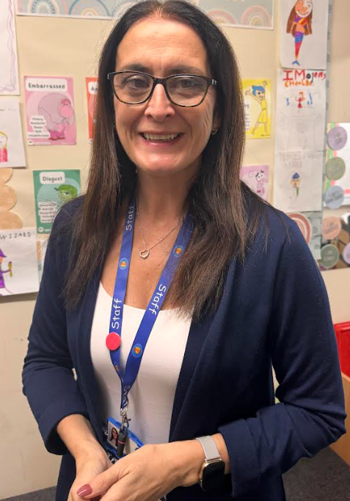
  Nurture groups – opportunity for children to engage in gardening, cooking, artwork while talking about their feelings.
  School Council – Elected representatives from each class who voice their peers’ thoughts and feelings, fostering a sense of responsibility and community involvement.
We track all of our children’s wellbeing progress and use additional assessment measures such as emotional literacy scales and Boxall profiles.
We work closely with parents and have previously held a family forum on mental health supported by the School Nurse Team, and Educational Psychologists. We work
closely with, Social Services, Family Support Workers, Family Lives and with professionals from the Child and Adult Mental Health Services (CAMHS).
For those children who are particularly struggling with their emotional and social development, we have a school ELSA who can provide them with support. Please see the role of our ELSA below.
The ELSA role
As Emotional Literacy Support Assistant (ELSA) I have completed a years’ professional training with the Educational Psychology Service in supporting children with social, emotional and mental health difficulties. I can offer support for a range of issues including bereavement, emotional problems, family break-up and friendship issues.
.

Slide 16
15. How does the governing body involve other bodies in meeting the needs of these pupils and supporting their families?
IIt is governors who hold the main responsibility for finance in schools, and it is governors who work with the head teacher to make the tough decisions about balancing resources.
The role of the governing body is a strategic one. It has three core strategic functions:
  To ensure clarity of vision, ethos and strategic direction
  To hold the head teacher to account for the educational performance of the school and its pupils, and the performance management of staff
  To oversee the financial performance of the school and make sure its money is well spent
Governors do not get involved in the day-to-day management of the school. That is the head teacher’s responsibility.
At Belton C of E Primary School the governing body comprises of a number of professionals, parents, staff members at the school and members of the local community.
16. What arrangements are made by the governing body relating to the treatment of complaints, from parents and carers of pupils with SEND, concerning the provisions made at our school?
Our governors will respond to complaints by following our complaints procedure.
Please refer to our complaints procedure on our school website:
https://www.belton.leics.sch.uk/website/statutory_policies/631180

Slide 17
18. The local offer
The Leicestershire Local Offer gives children and young people with special educational needs or disabilities (SEND) and their families’ information about help and services in Leicestershire.
The Local Offer brings together in one place information about health, education and social care for:
  children and young people from birth to 25 years old who have a Special Educational Need or Disability (SEND)
  parents and carers of children with SEND
  professionals working in health, care and education
  providers of services for children and young people
In Leicestershire, our SEND Local Offer consists of the Local Offer home page, and the Information and support directory.
https://www.leicestershire.gov.uk/education-and-children/special-educational-needs-and-disability

Slide 18
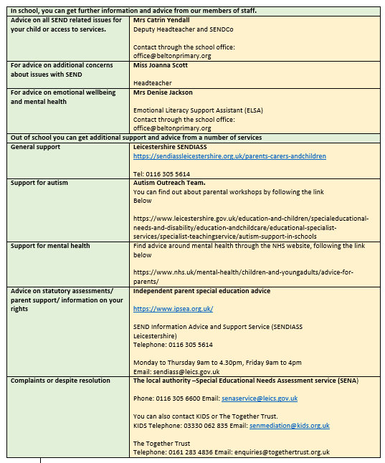
Leicestershire Local Offer website - https://www.leicestershire.gov.uk/education-and-children/special-educational-
needs-and-disability

