Slide 1



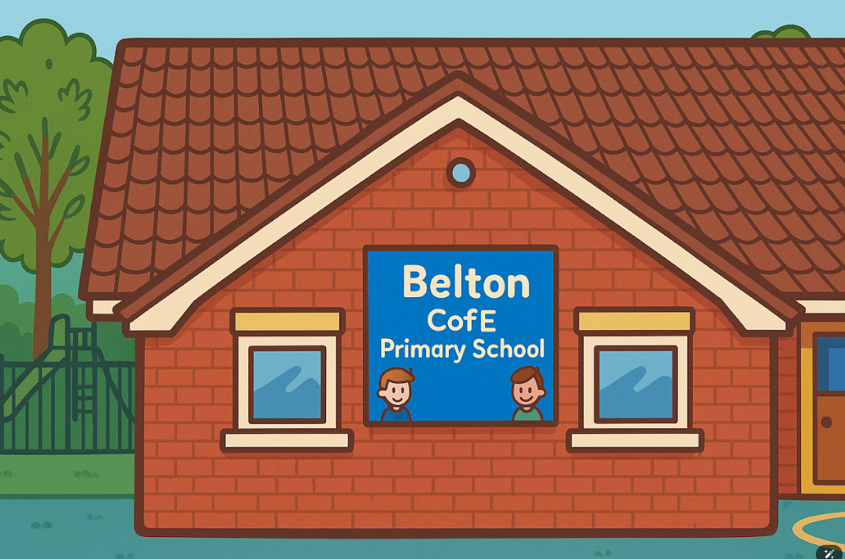



Welcome to our SEN coffee morning

Slide 2









What does SEND look like at Belton?
How can you support at home?
Parent Information Report
What would you like to see next?
How do we support our learners with dyslexia?

Slide 3


Understanding Special Educational Needs Together
Special Educational Needs (SEN) support is designed to help children thrive in their learning journey. By collaborating with parents, teachers, and specialists, we can create a nurturing environment. This empowers children to reach their full potential, ensuring that every child feels included and valued in their educational experience.
Every child deserves support and understanding on their learning journey.

Slide 4
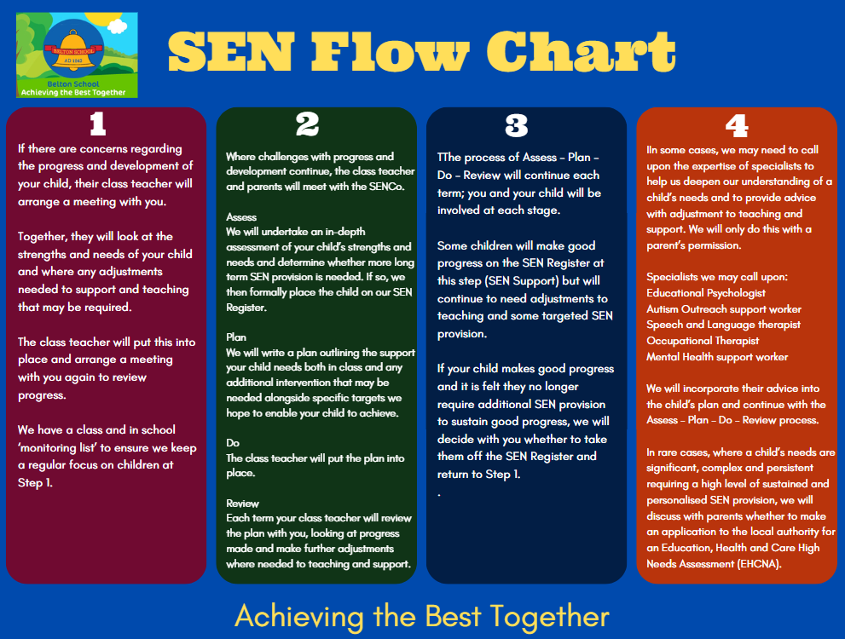
What does SEND look like at Belton?
Being on the register does not mean a 1:1 it means that we will provide extra support/ intervention within the classroom

Slide 5
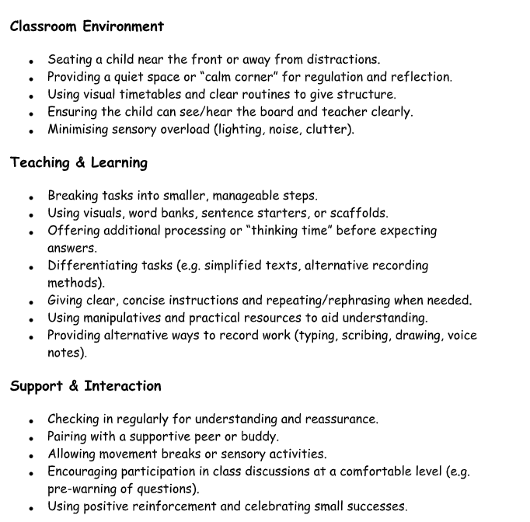
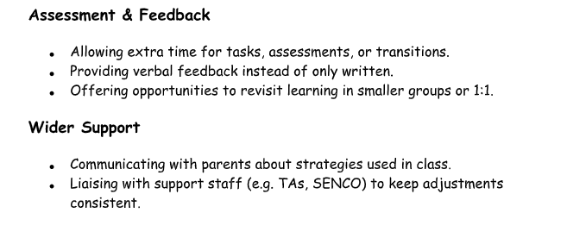
How do we support the children?
We talk to the children and listen to what they need
Computers, mind maps, talking tins, headphones,
wobble cushions, word mats

Slide 6
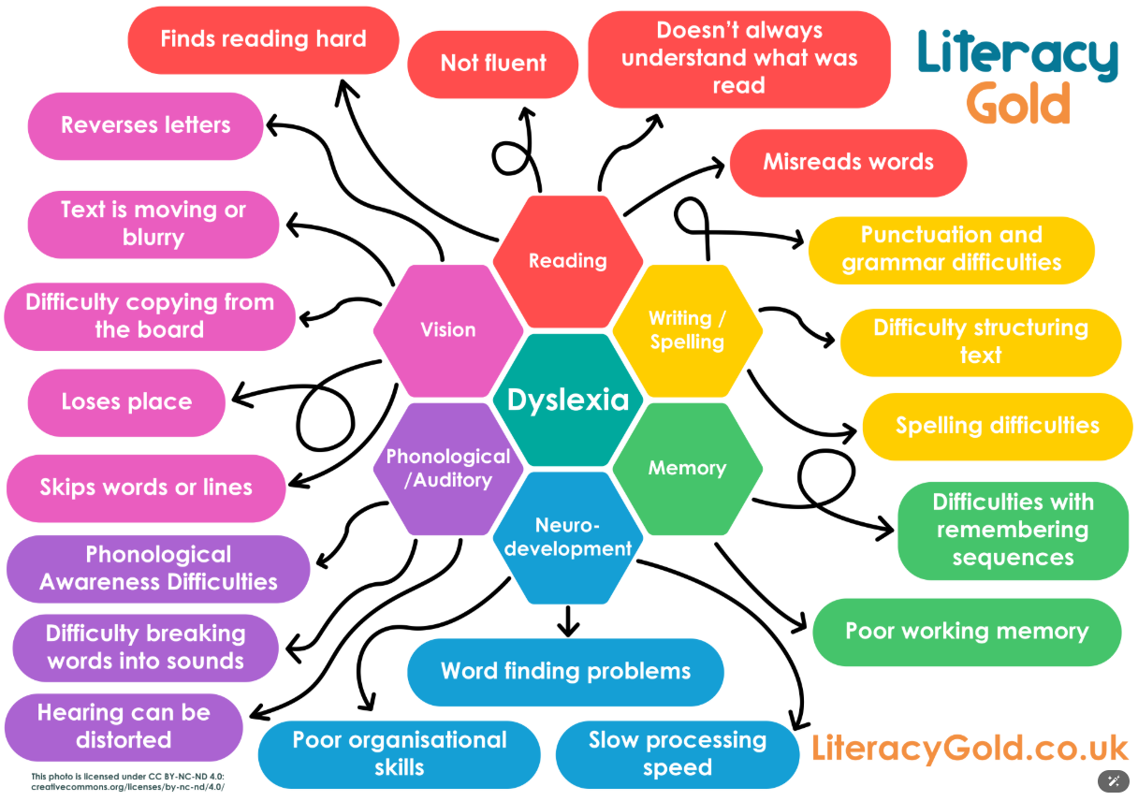
Dyslexia & Visual Convergence

Slide 7
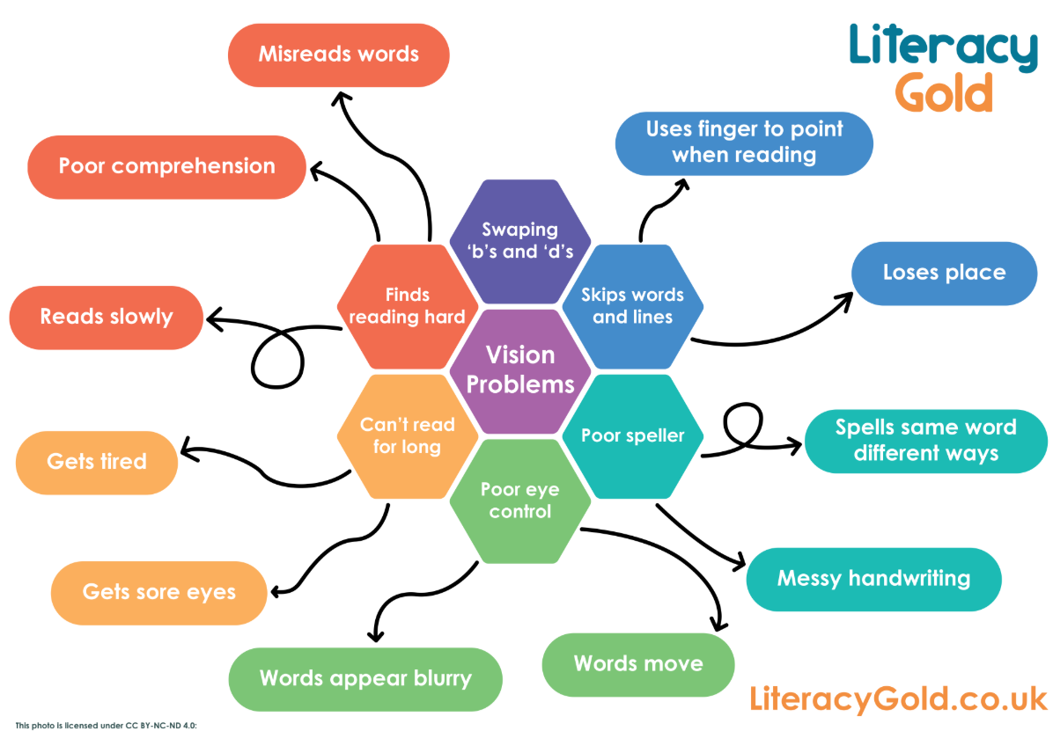

Slide 8
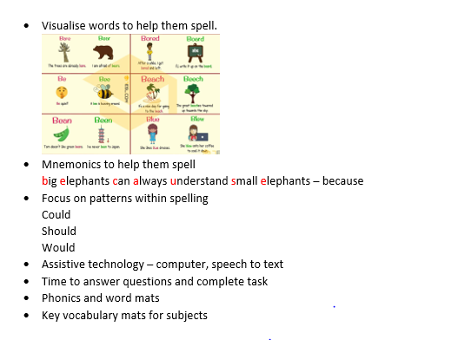
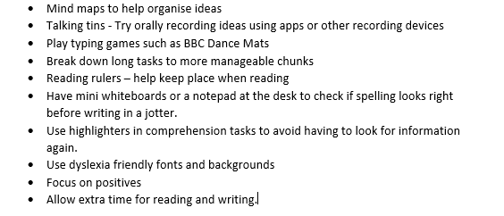

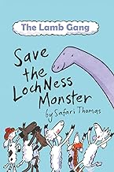

How do we support the children?

Slide 9
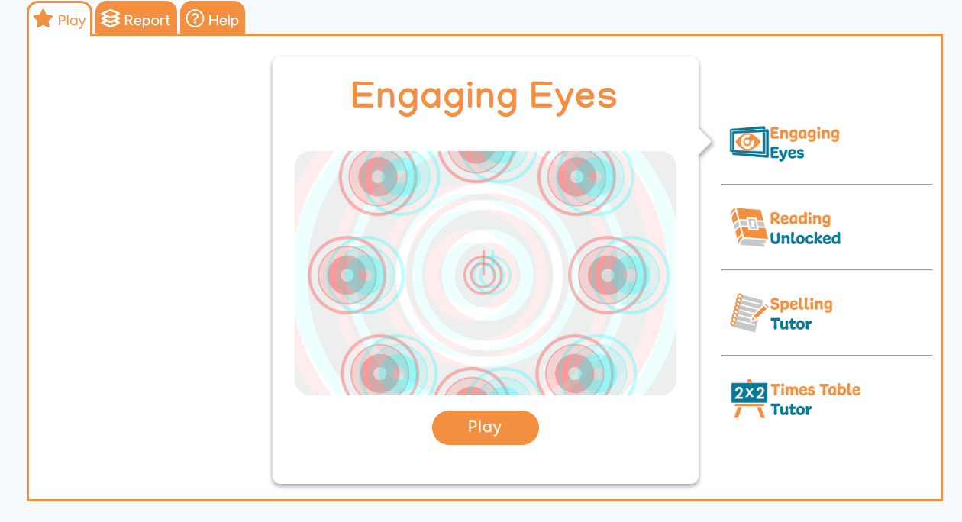
Literacy Gold

Slide 10
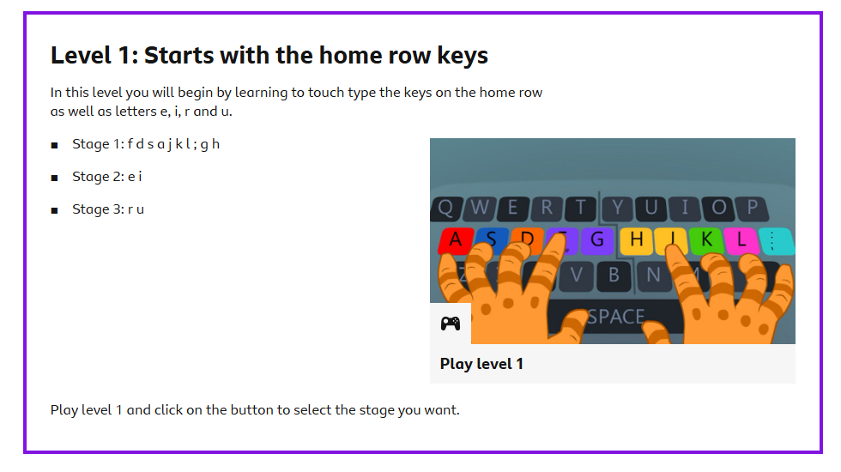


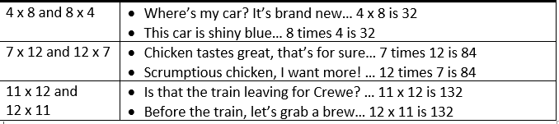
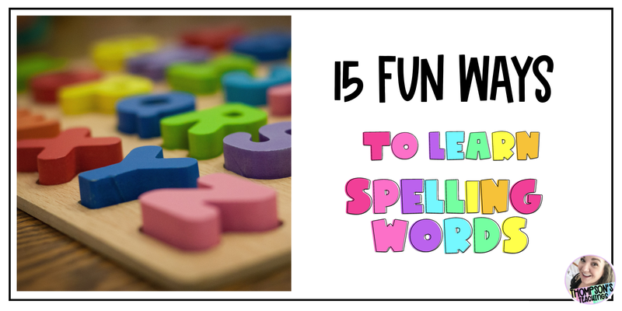
How can you support at home?
Reading - paired, I read/ you read, audiobooks
BBC Dance Mat Typing
Times Tables - learn rhymes, pop songs
Make spelling fun
Create rhymes (said - silly ants in dynamite), write in foam etc

Slide 11


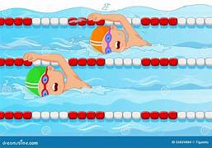

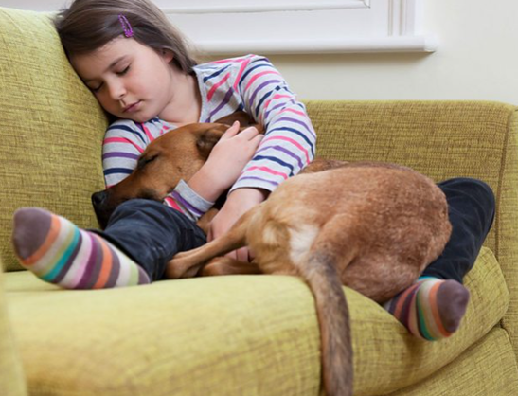
Celebrate strengths
Little and often
Learning one-on-one or in small groups is much more intense than a normal school day.
This is exacerbated for a dyslexic learner, because of way the dyslexic brain works - they tire faster.
It’s much better to get a smaller amount of quality teaching time in each day.

Slide 12

Your feedback

Slide 13




Any questions?

Slide 14
Future mornings

