Slide 1

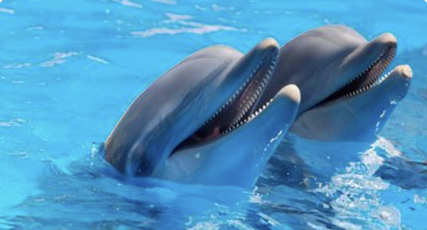
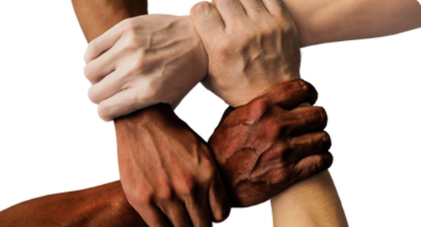









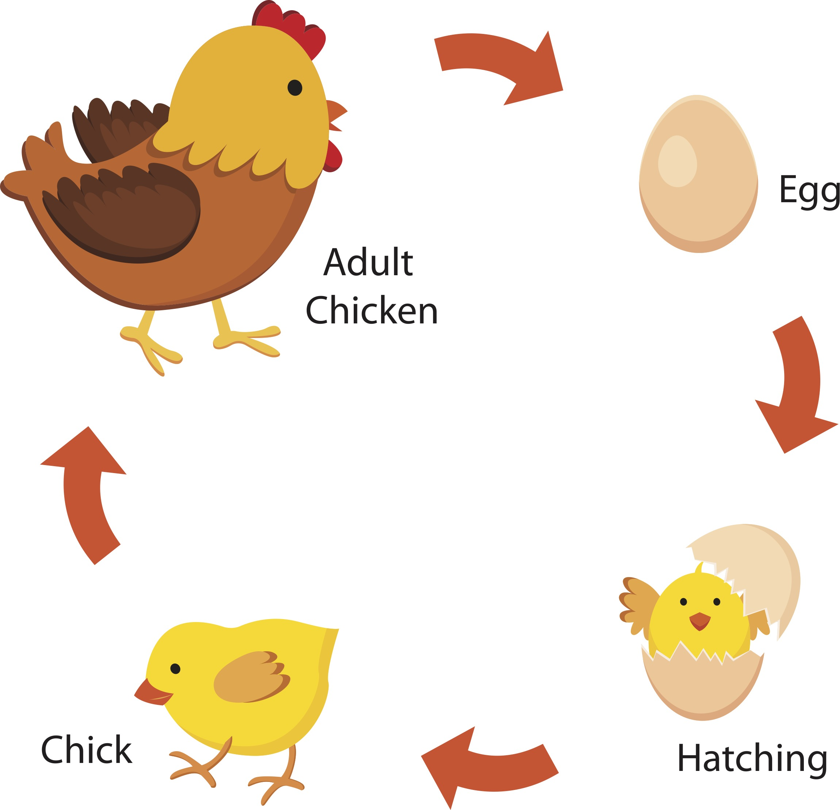
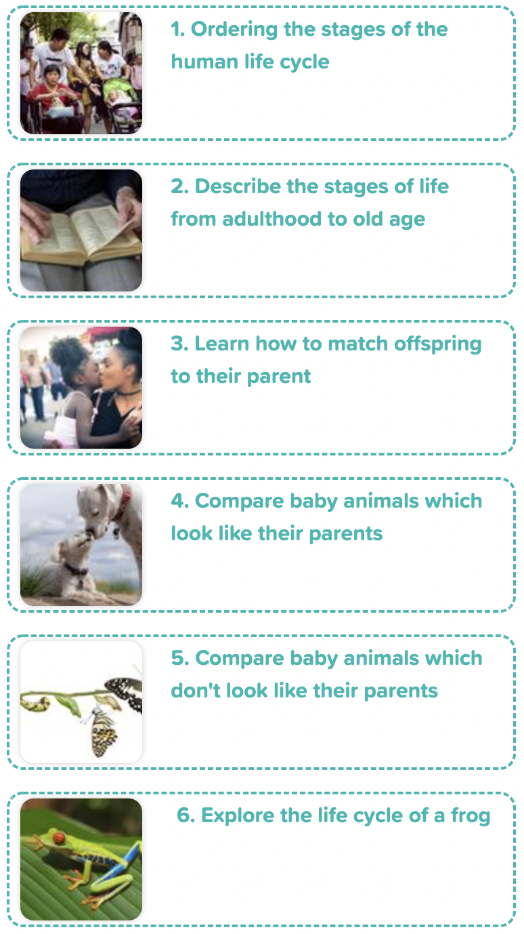
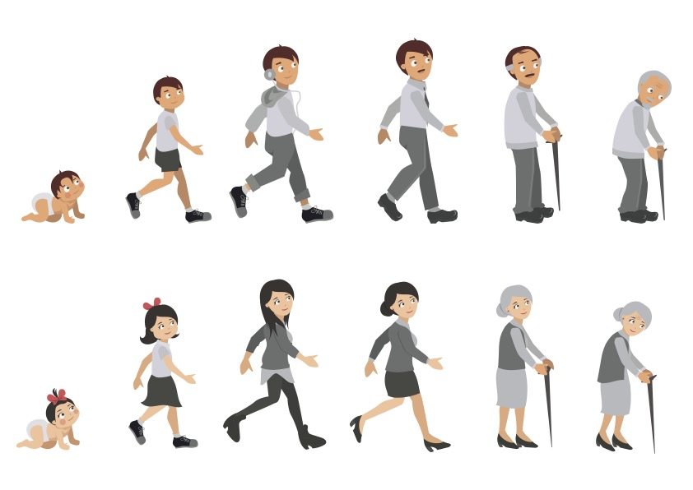
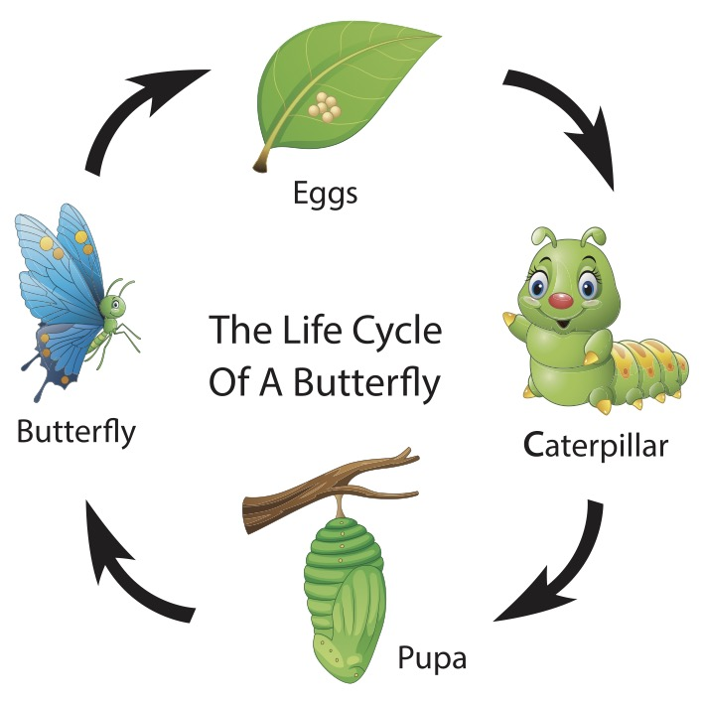
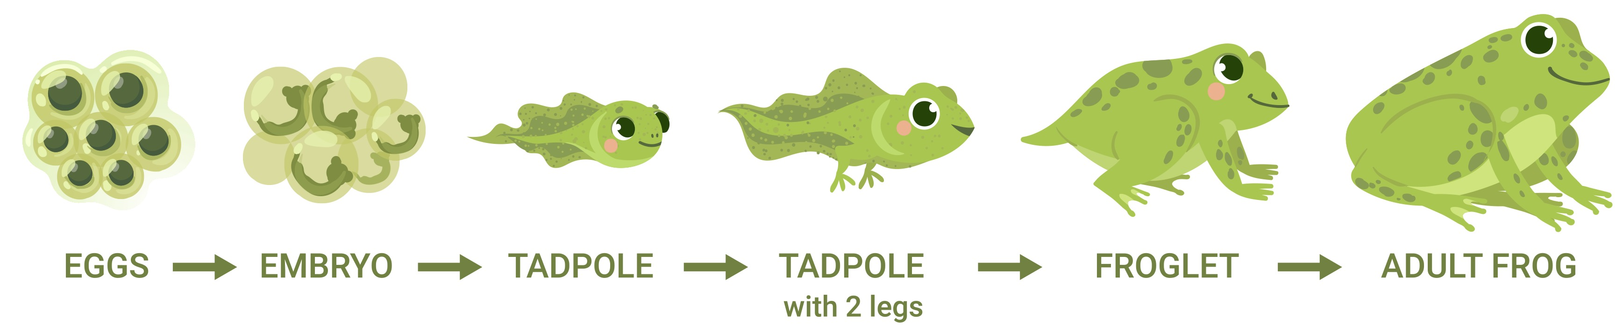
Careers connected to human’s life cycle:
midwife, medical receptionist, radiologist
Knowledge Organiser: Animals, including humans 2 - Life cycles
Careers connected to the human body:
doctor, nurse, massage therapist, personal trainer, theatre technician
Human Life Cycle
Chicken Life Cycle
Lesson Sequence
1. Learn how to order the stages of the human life cycle
2. Describe the stages of life from adulthood to old age
3. Learn how to match offspring to their parent
toddler
child
teenager
adult
old age
4. Explore the life cycle of a chicken
Butterfly Life Cycle
Frog Life Cycle
5. Describe the life cycle of a butterfly
1. Eggs – Female lays eggs which are fertilised by the male.
2. Tadpole – After 2-25 days the tadpole hatches from egg.
3. Jumps – Grows front legs. Uses nutrients in tail as food.
4. Grows fins and hind legs.
5. Adult Frog – Eats insects instead of plants. After 2-4 years it becomes an adult frog and can lay eggs.
6. Explore the life cycle of a frog
Developing Experts Copyright 2022 All Rights Reserved

