Slide 1



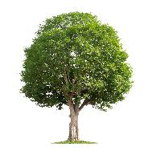
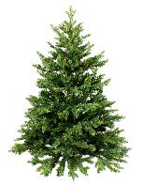

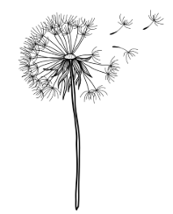


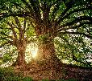
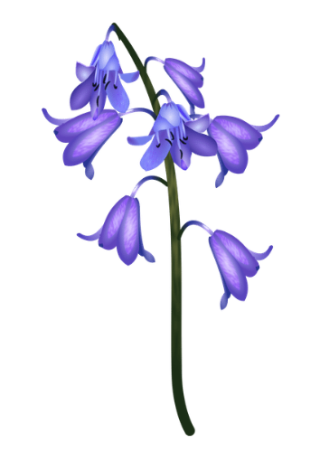
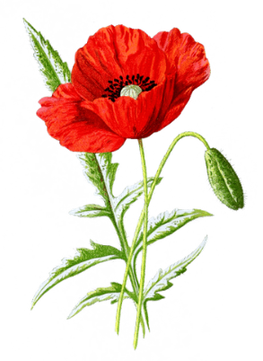
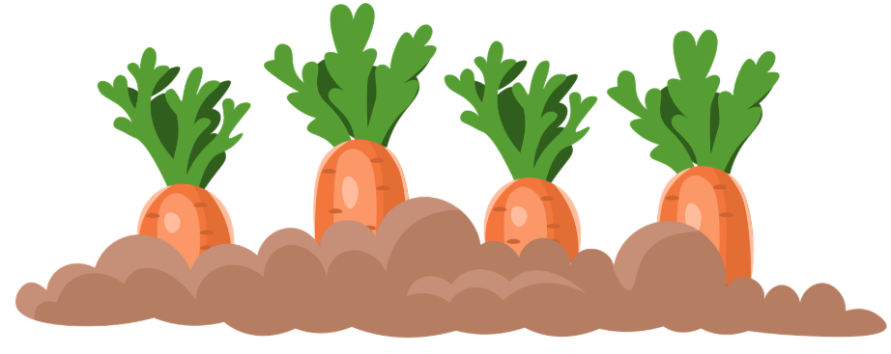

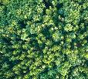

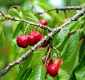
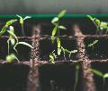
Year 1: Plants
Knowledge Organiser
Careers connected to this unit: botanist, farmer, florist, gardener
Lesson Sequence
Types of trees
Wildflowers
Common garden plants
1. Understand that seeds grow into plants
flowers that are not planted by a person
a plant people grow and care for in their gardens
2. Identify the basic parts of a plant
buttercup
dandelion
rose
sunflower
deciduous
trees that drop their leaves every year
evergreen
trees that keep their leaves all year round
3. Identify common wild plants
bluebell
poppy
carrot
Structure of a tree
Structure of a plant
4. Know the difference between deciduous and evergreen trees
branch
flower
leaf
seed
5. Know that fruit trees and vegetables are varieties of plants
leaf
trunk
stem
roots
6. Explain how plants change over time
root
Developing Experts Copyright 2025 All Rights Reserved

Slide 2


Year 1: Plants
Knowledge Organiser
Careers connected to this unit: botanist, farmer, florist, gardener
Rocket Words
grow | to get bigger and change over time
seasons | changes in weather and temperature throughout the year.
wild | flowers that are not planted by a person but have spread their own seeds
flower | part of a plant that has petals
root | part of a plant that grows underground
leaf | part of the plant that makes food for the plant
stem | part of the plant that supports the flower
seed | a small part of a plant that can grow into a new plant
fruit | part of a plant that has seeds and can be eaten
Developing Experts Copyright 2025 All Rights Reserved

