Slide 1
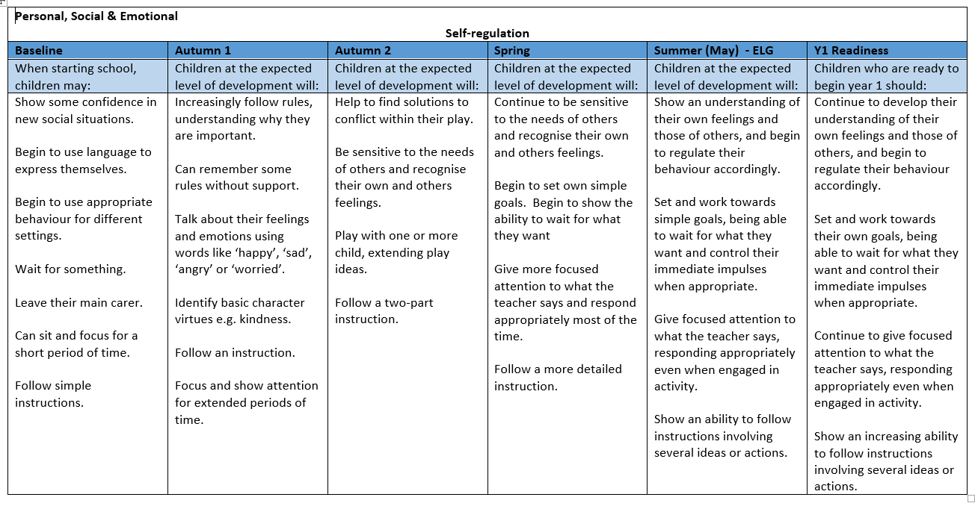

Slide 2
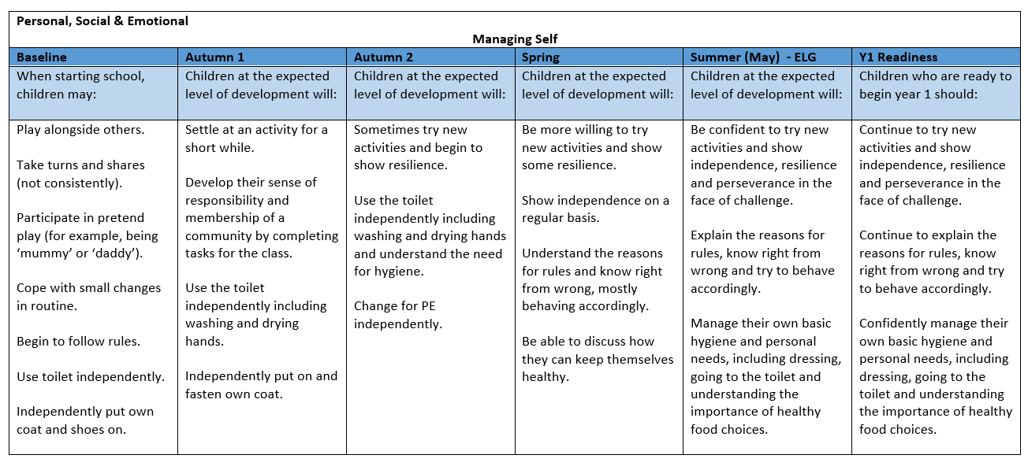

Slide 3
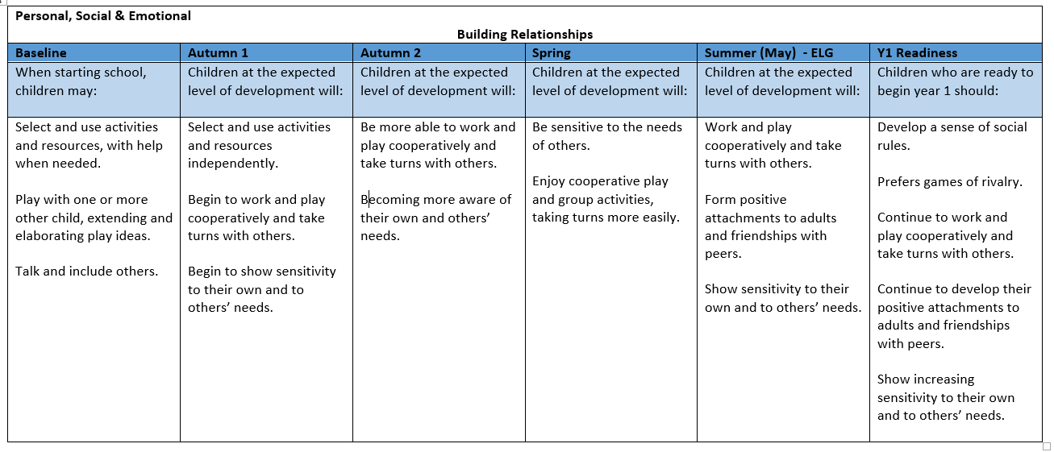

Slide 4
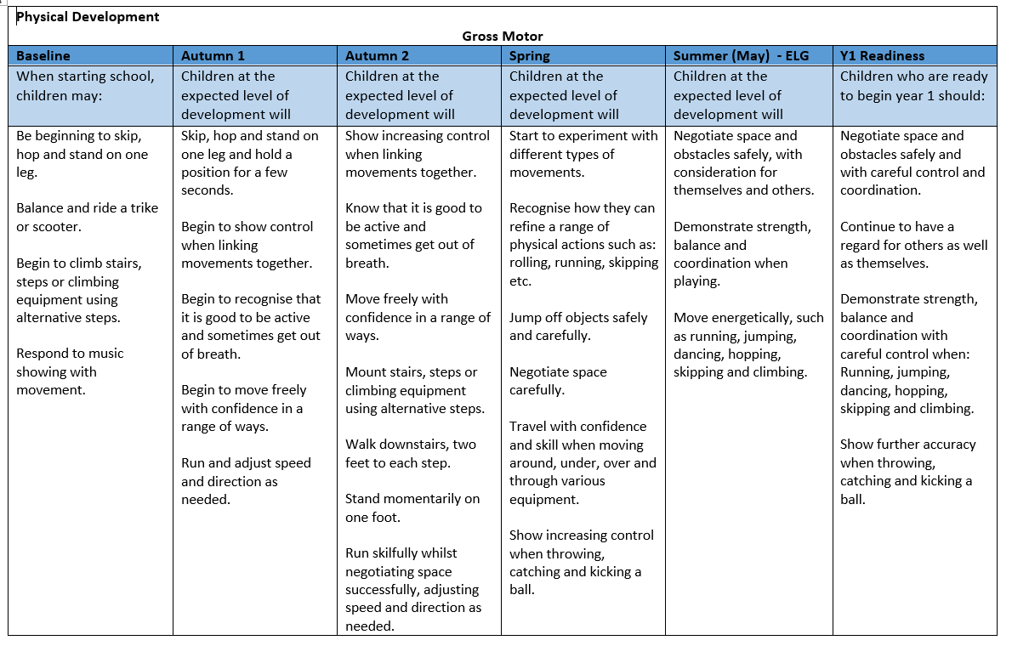

Slide 5
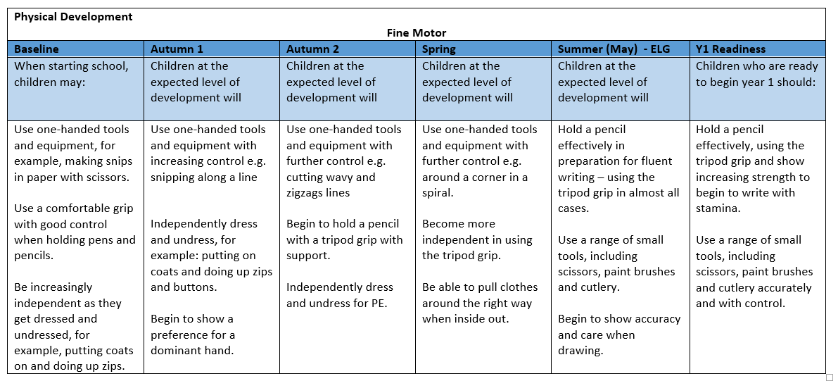

Slide 6
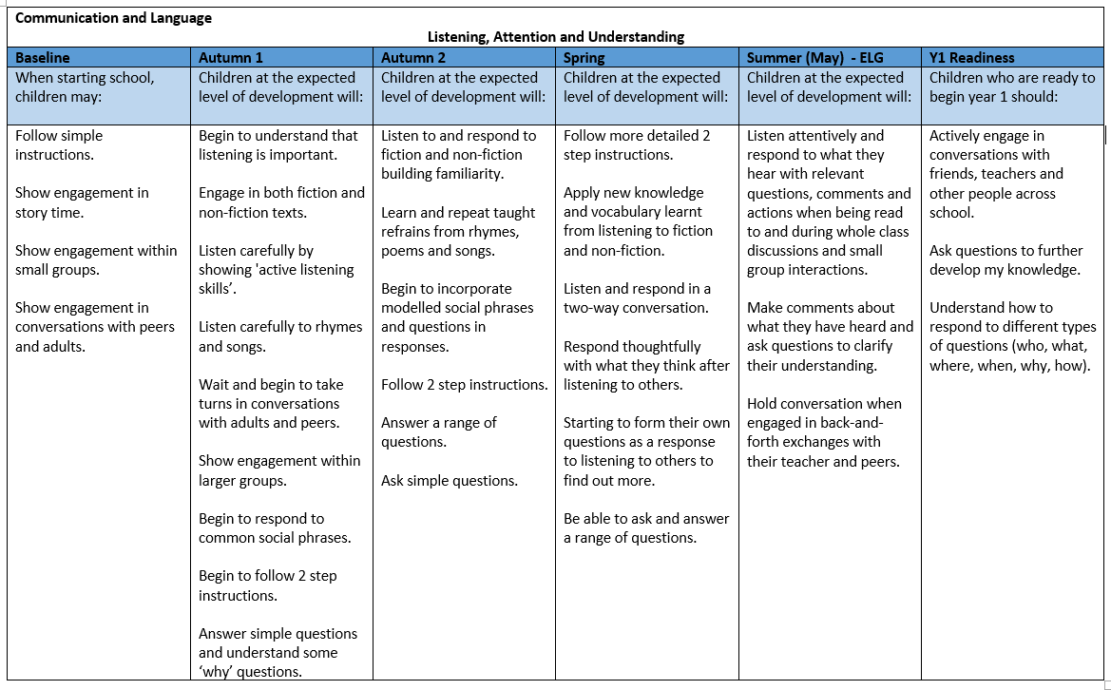

Slide 7
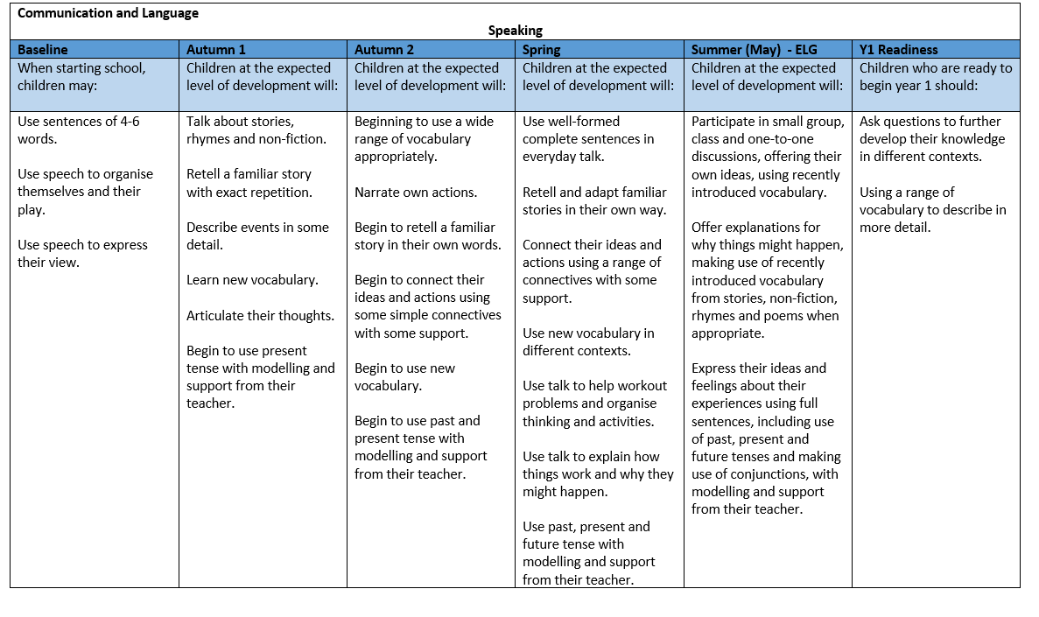

Slide 8
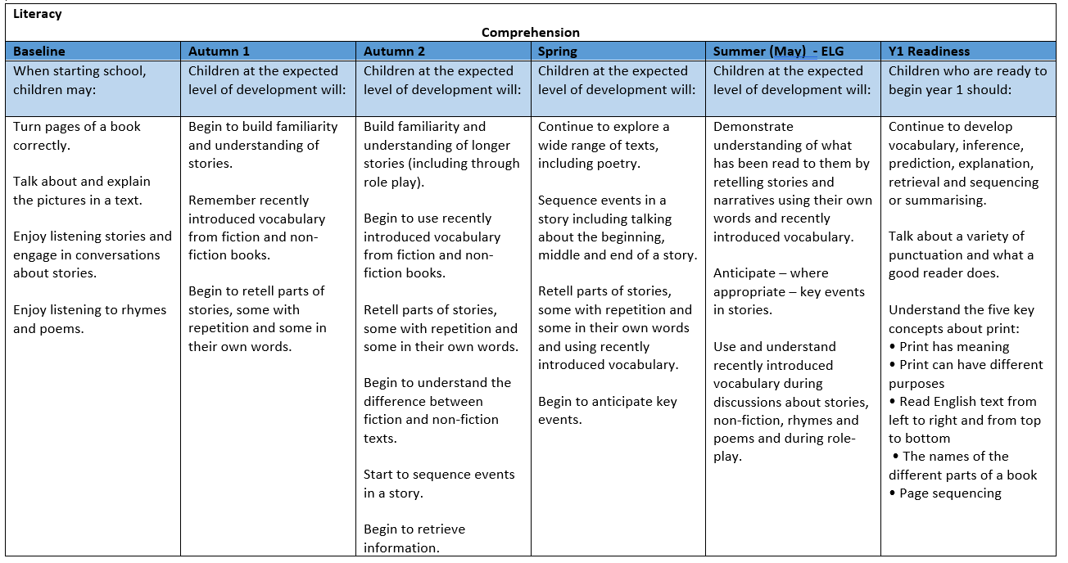

Slide 9
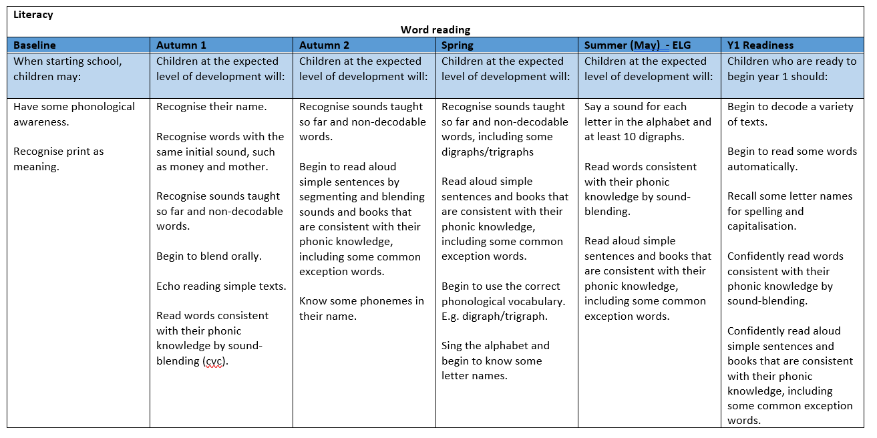

Slide 10
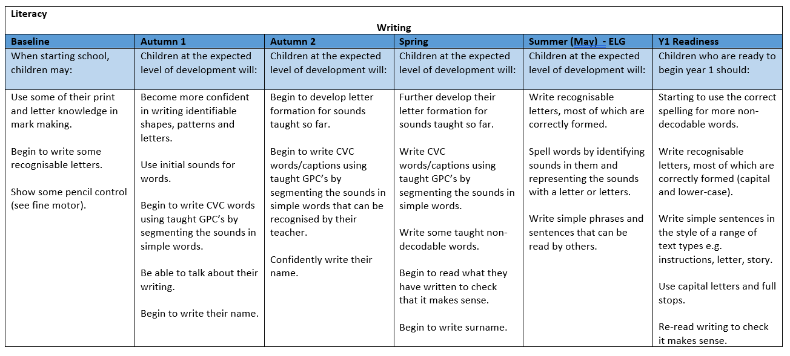

Slide 11
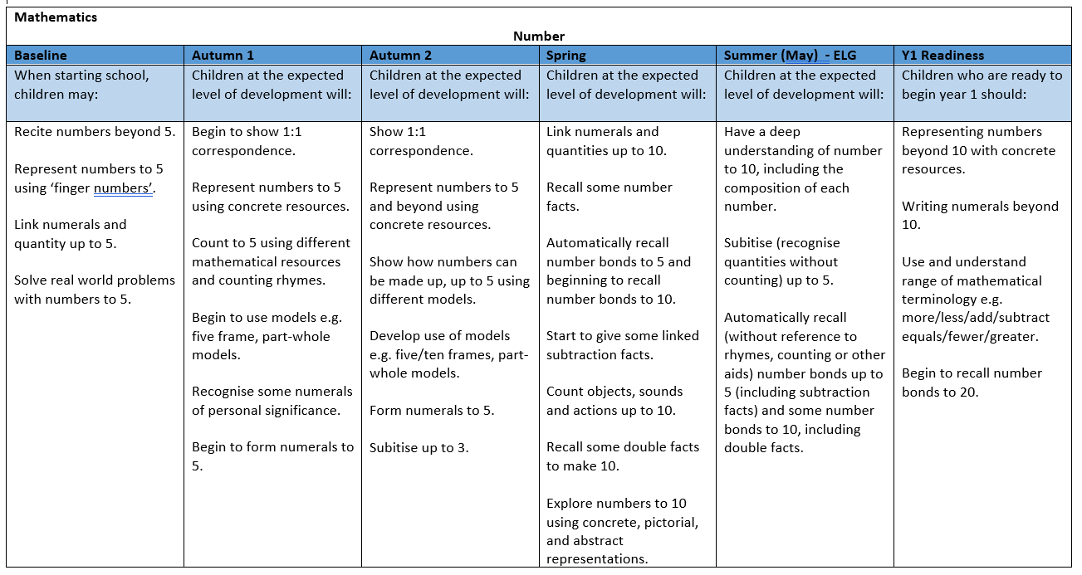

Slide 12
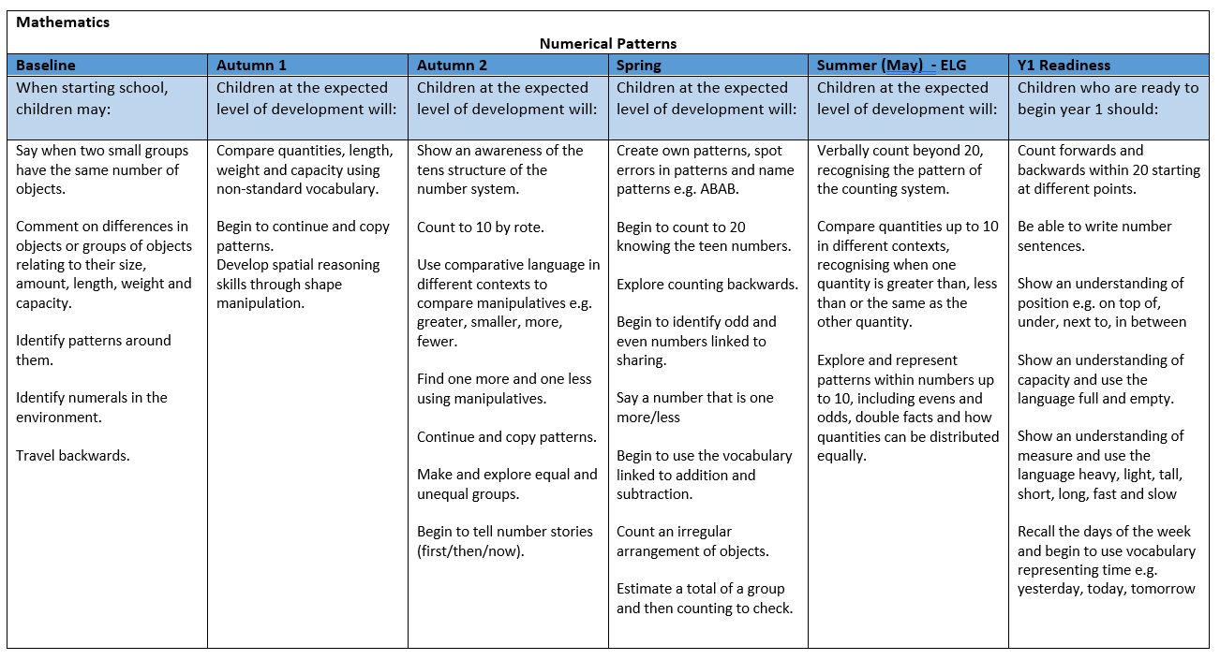

Slide 13
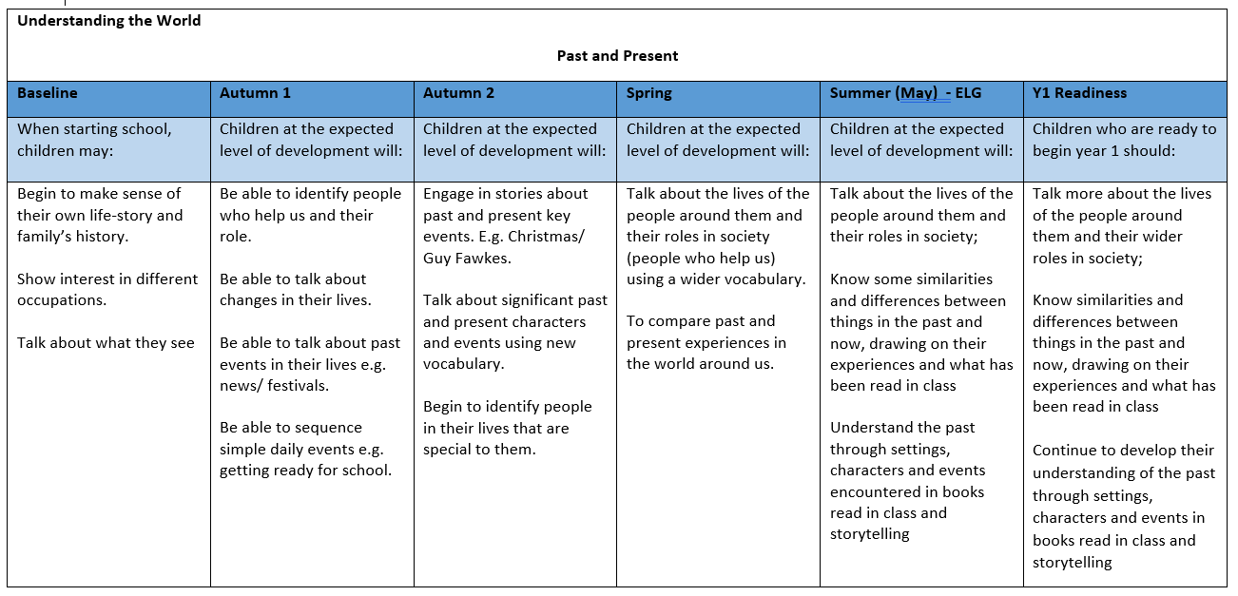

Slide 14
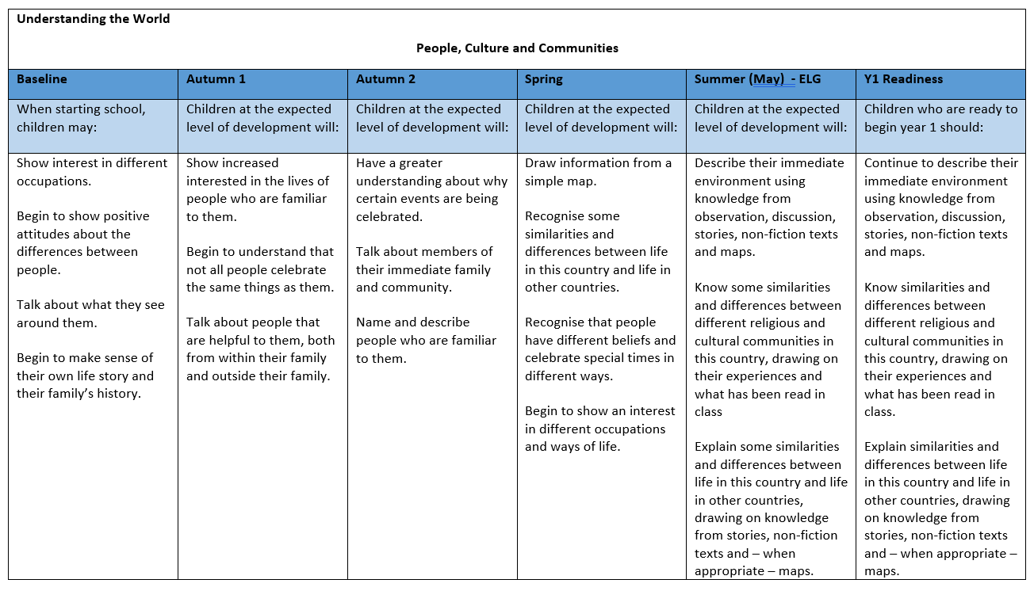

Slide 15
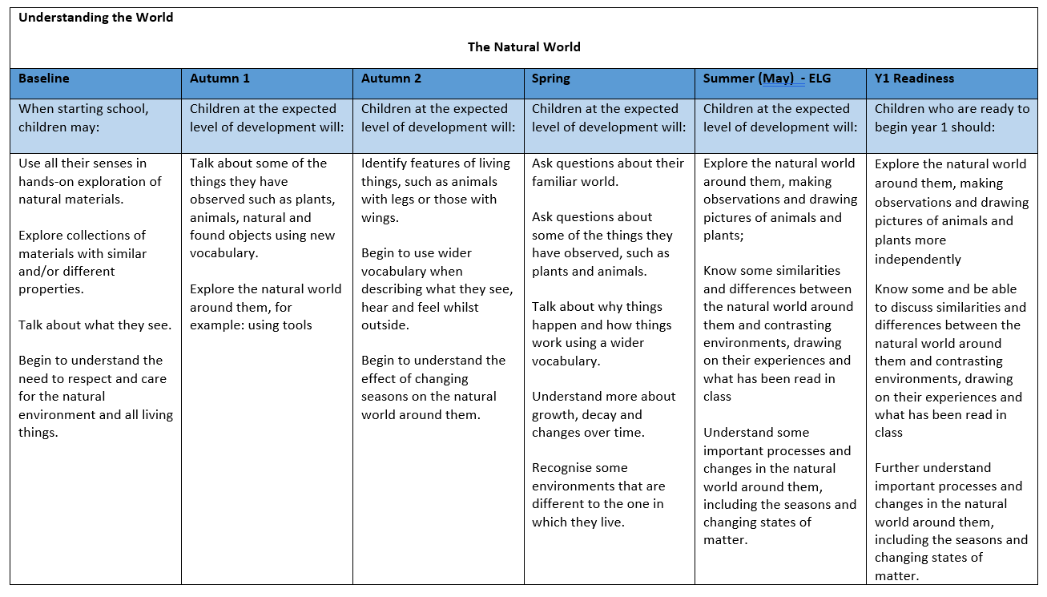

Slide 16
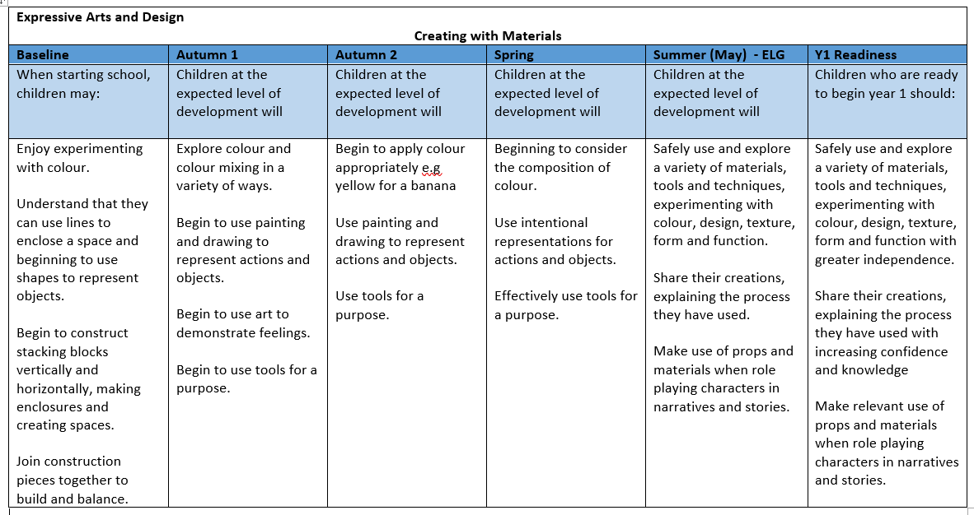

Slide 17
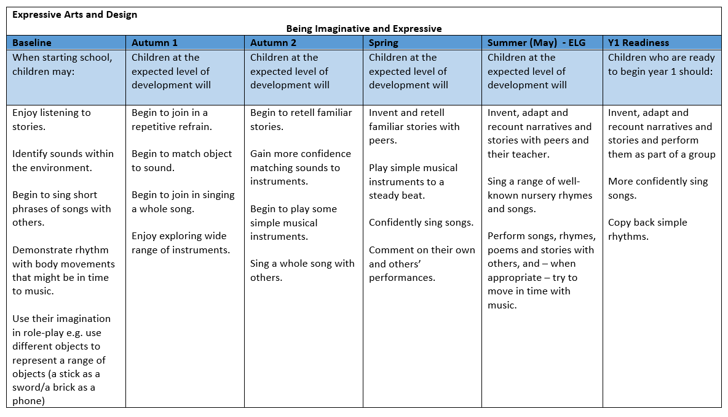

Slide 18
Personal, Social & Emotional Self-regulation
Baseline | Autumn 1 | Autumn 2 | Spring | Summer (May) - ELG | Y1 Readiness
On track? | On track? | On track? | On track? | On track? | On track?
Notes: | Notes: | Notes: | Notes: | Notes: | Notes:

Slide 19
Personal, Social & Emotional Managing Self
Baseline | Autumn 1 | Autumn 2 | Spring | Summer (May) - ELG | Y1 Readiness
On track? | On track? | On track? | On track? | On track? | On track?
Notes: | Notes: | Notes: | Notes: | Notes: | Notes:

Slide 20
Personal, Social & Emotional Building Relationships
Baseline | Autumn 1 | Autumn 2 | Spring | Summer (May) - ELG | Y1 Readiness
On track? | On track? | On track? | On track? | On track? | On track?
Notes: | Notes: | Notes: | Notes: | Notes: | Notes:

Slide 21
Physical Development Gross Motor
Baseline | Autumn 1 | Autumn 2 | Spring | Summer (May) - ELG | Y1 Readiness
On track? | On track? | On track? | On track? | On track? | On track?
Notes: | Notes: | Notes: | Notes: | Notes: | Notes:

Slide 22
Physical Development Fine Motor
Baseline | Autumn 1 | Autumn 2 | Spring | Summer (May) - ELG | Y1 Readiness
On track? | On track? | On track? | On track? | On track? | On track?
Notes: | Notes: | Notes: | Notes: | Notes: | Notes:

Slide 23
Communication and Language Fine Motor
Baseline | Autumn 1 | Autumn 2 | Spring | Summer (May) - ELG | Y1 Readiness
On track? | On track? | On track? | On track? | On track? | On track?
Notes: | Notes: | Notes: | Notes: | Notes: | Notes:

